Slide 1
ASIEQ Quarterly
General Meeting
20th February 2019
Association of Self Insured Employers of Queensland

Slide 2


Back to Basics to Build a Better Future
Developing a Platform for 2019 Today’s Forum is a Trial to determine
what the future may hold.
In addition to the Hopper issues and
Audit Protocols we need to establish what the
Meeting/Forum for the 15th May should look like.
Is this a way to improve collaboration between members?

Slide 3
Updates since the November Forum
Communication Strategy – LinkedIn – ASIEQ Members Group
  Need to promote LinkedIn availability and usage by members.
Production of draft by-laws to delayed to 30th April because of Conference commitments.
Susan Atme appointed Contract Manager to over see Secretariat.
  Contract expires 31 July 2019 – tender process required.
Office of Industrial Relations held forum 3rd December to discuss:-
  Self Insurance Performance and Compliance Framework
  Workers’ Compensation Compliance and Enforcement Policy
Members advised policy/documents to be released by 31 December with all other documents to be released by 30 June 2019.
Subsequent extension provided to 31 January. Further input by ASIEQ to be discussed by David Gomulka. Still awaiting Regulator Sign Off.
Licence Managers invited to attend Forum on the 28th February 2018 must RSVP by 25 February. The forum is to discuss the claims and rehabilitation performance management auditing of self insurers.
Note:- This topic to be reviewed in group discussion in todays forum

Slide 4

2019 Back to the Future of Injury Management Conference Update

Slide 5

Conference Six Page Flyer & Program Released

Slide 6
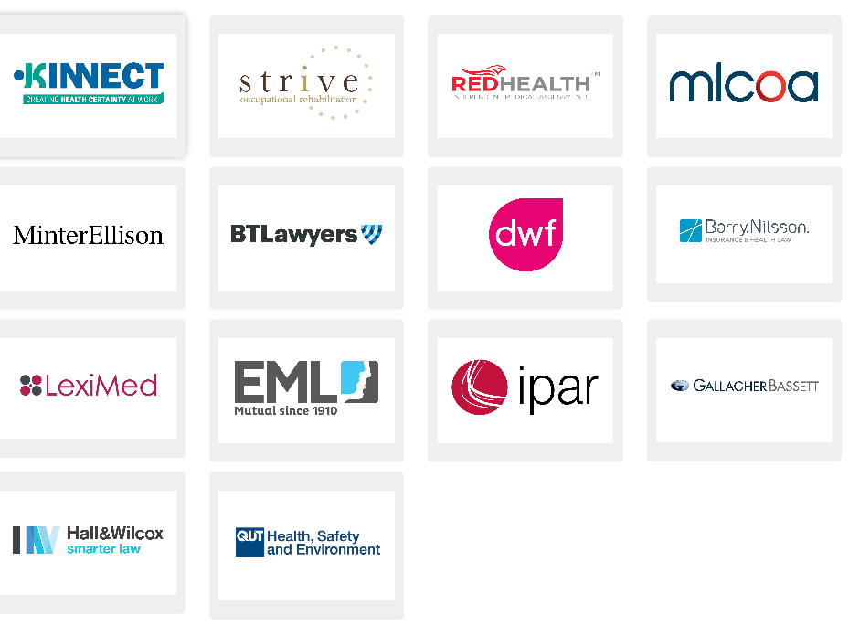
Thank you to our Table Sponsors

Slide 7
Important Information about the Conference
Approximately 230 Seats have been sold to date
This includes 24 tables of 8 Seats (192 Seats)
ASIEQ has 2 tables which have been on sold to members
Members tickets price-$625 + GST until 28 February
Current Rate $1220 +GST p/p (Less $200 Supporters Discount )
Over $159,000 in invoices issued to date
Current costs incurred approximately $156,000
Further income to be used to improve Conference e.g.
    ASIEQ to sponsor coffee cart
Would appreciate assistance promoting the conference
Note - Bookings to Close on 11th March

Slide 8
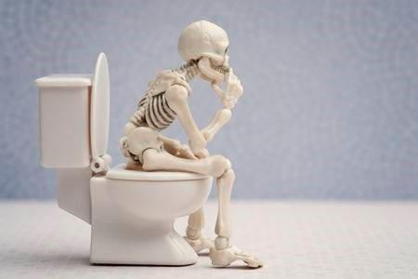
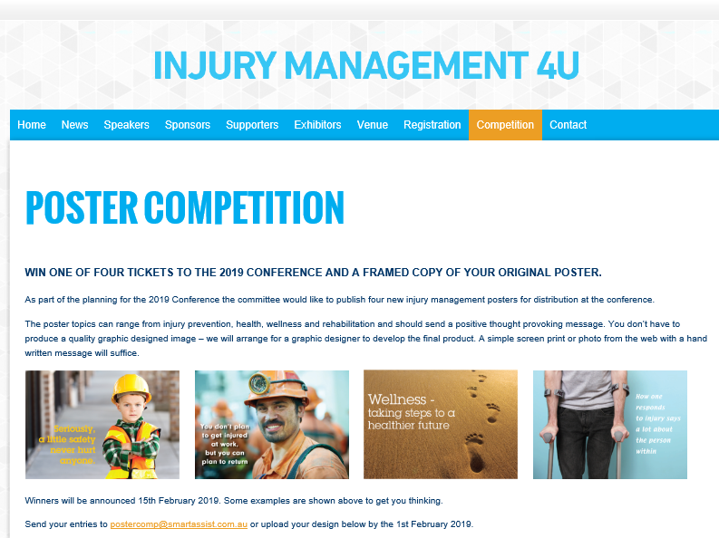
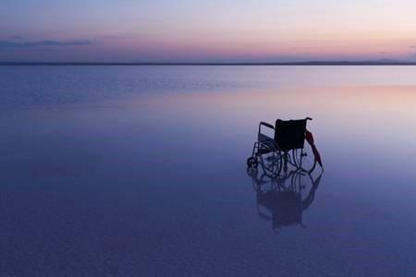
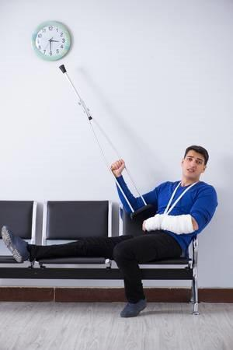
Poster Competition
Judging to occur Next Week

Slide 9
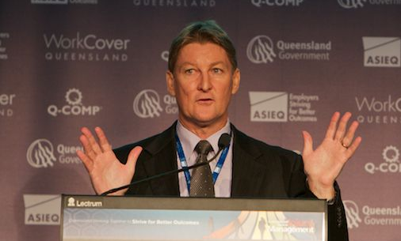
Meeting with Tony James
A/Director General – Regulator
OIR and Executive Meeting 30th January
Meeting Notes were distributed to Members on the 7th February.
Also recently circulated with Meeting Agenda are there any issues arising from the minutes of the meeting?
Initial Meeting on the 21St February
(Younger Version of Tony – 2011 – Leadership and Vision Conference )

Slide 10
Worksite Wellness Program Manager Course

Slide 11
PIEF Update – Personal Injury Education Foundation
Sue Crawford CEO PIEF has been asked about training options for QLD
Sue will be attending the Back to the Future Conference
Working Parties should seek out Sue at the conference
PIEF to hold their Bi-annual Conference and Awards in QLD 2020
WorkCover Update
Informal meeting with Sharon Stratford & Laurent Cazier
New Premium Structure being offered – Burning Cost Model?
Open to approaches by entities that want to return to WorkCover
Would consider joint working parties on audit issues.
In Closing any Questions?

