Slide 1
Monthly Insurer Reporting
Zoe Hodgetts
ASIEQ Quarterly Forum
08-05-13

Slide 2
Overview
Reasons for change
Benefits
New report
Release date
Questions

Slide 3
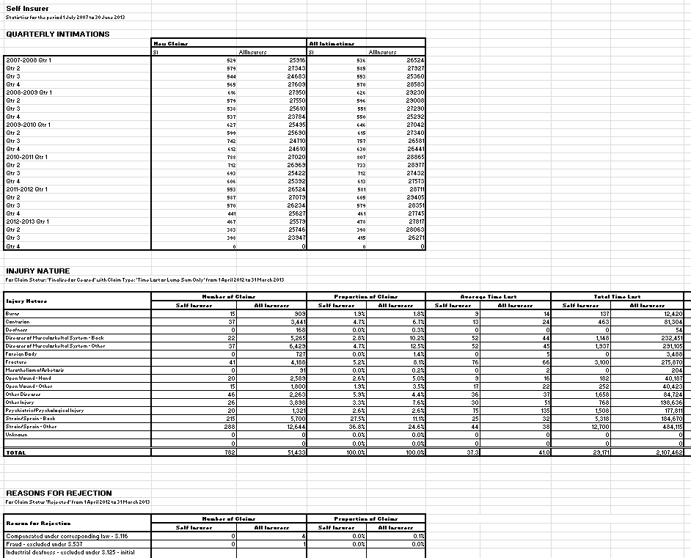
Current report

Slide 4
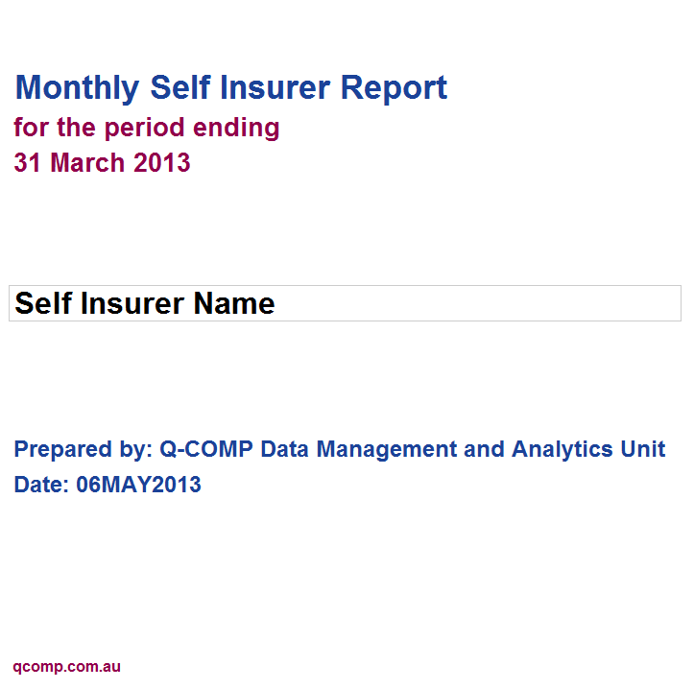
New report

Slide 5
Questions?
statistics@qcomp.com.au

