Slide 1
Host employment – our experience
ASIEQ forum
Matthew Bannan
Executive Professional Services
21 November 2018

Slide 2
What is host employment?
Our own Recover at Work (R@W) program i.e. our own employers who sign up to be a recover at work employer; and
Host employment placements including:
RTW Services provider sourced placements
Cold sourced placements i.e. by our staff through their own networks and contacts
Worker sourced placements i.e. worker uses their own networks and contacts

Slide 4
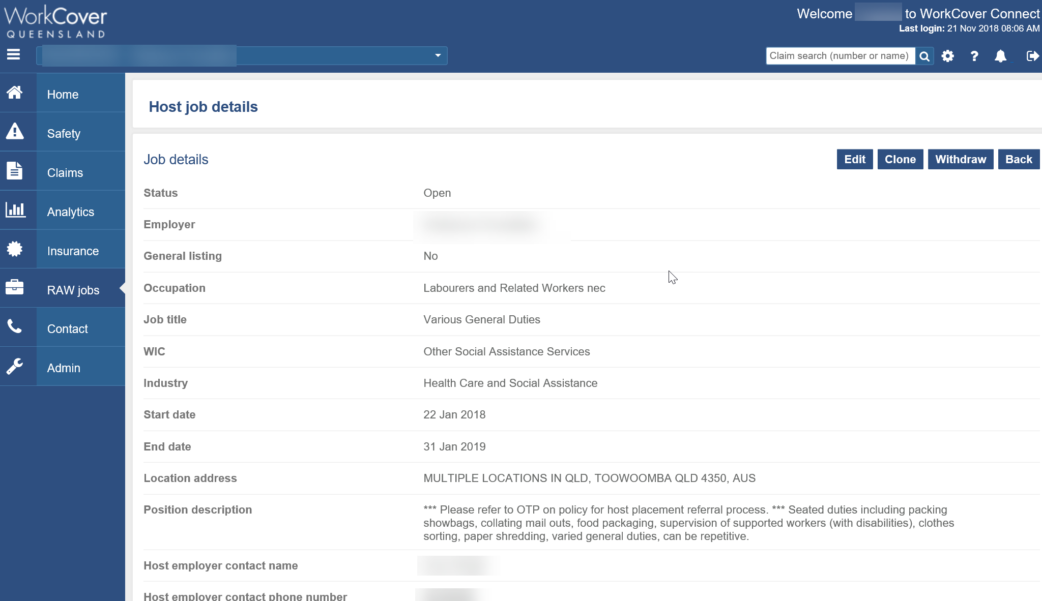

Slide 5
What does it mean to our people?
RTW
Work hardening
Capacity
Rehabilitation
New employer
New job
New career
New skills
Work experience
Using skills in other ways
Support
Recovery
Engagement
Sense of purpose
RTW Services providers
Reducing costs and improving outcomes
Different sources – worker; RTW Services provider; R@W; cold; Gov2Gov R@W

Slide 6
Our role in this RTW journey
Injured worker
Communication
Rehabilitation
Suitable duties
WorkCover
WorkCover
Employer
RTW
Medical and Allied Health Providers
Safety
Reporting
Communication
Support
Suitable duties
Timely services
Communication
Rehabilitation
RTW focus

Slide 7
What do we know about host employment?
Industries
R@W employers
Numbers
Costs and outcomes
Host deed/exemptions
Common law

Slide 8
What is our focus?
Gov2Gov Recovery at Work pilot
Early intervention – offer the right help at the right time including host employment
Sustainable RTW focus – more understanding and increased learnings from successful and unsuccessful host employment placements (links to Recovery Blueprint) – who, when, why and how
Better use of technology – better visualisation for our people; improved online support and functionality for our customers (WorkCover Connect, Worker Assist and Provider Connect)
Incentives
Recover at Work refresh

Slide 9
Thank you

