Slide 1
Jenny Legge BPhty, MErg Managing Director, JobFit Systems International PhD Candidate, The University of Queensland
Start Before the Beginning
and Finish after the End
Notes:
Thank you ….
And thank you for inviting me here today

Slide 2
Health
Notes:
Justin asked me to talk about People Risk Management throughout the employee continuum. … pre-employ / injury mx / post rehab / health monitoring / post employ or redeployment.
Why is this important – all this health and wellness stuff? Is it about compliance? That used to be the primary reason, but we’ve matured since then. Is it because it makes financial sense? We are certainly starting to appreciate the potential of our return on investment in health. Is it because it is the right thing to do? Yes, but that’s a given.
I think there is a another reason too. The way I see it, health is the new status symbol. It’s one of the most valuable things we can attain. We can’t buy health. We can’t win health. We can’t be gifted health. We have to work for it – to attain it AND maintain it. It is something that everybody wants, but not everybody has the commitment, tools and resources to achieve. And employers that provide those, will be the employers of choice and will be all the wealthier, and healthier, for it.

Slide 3
Commitment
Notes:
Before we get started, what’s your level of commitment to this process? Are you a pig or are you chicken? That’s a bit in your face, isn’t it? ☺ Let’s make it a bit more comfortable for you, what’s the level of commitment of your organisation to achieving a healthy workforce?
Now, I admit, that I feel like a bit of a hypocrit standing here before you today, talking about health. Look at me. I’m not as healthy as I could, or should be. But I’m working on that. Those of you that have known me for a while will, hopefully have noticed, that even though I am still tired from too many late nights, I am losing weight. I am now committed to improving my health.
How committed are you to improving the health and wellness of your workplace?
We’re all familiar with ham and eggs? Who’s more committed, the chicken who lays a new egg every day, or the pig who dedicates his life? I’m not asking anyone to give up their life! It’s more a question of, are you prepared to make a commitment for the long haul or are you just going to jump from one thing to another with a bit here and there?

Slide 4
Continuum
Pre-Employment
Periodic Employment
Post Employment
Notes:
So, if we are going to be measuring and monitoring something from one time to another – whether that be from pre-employment through to redeployment, or just during the course of a rehab program, We need consistency in our approach. If we want to measure something and then measure it again, we need something that is reliable. So that if we have changes in the results, its because of a change in the worker, not because of a change in the way they were measured, or the way the results were interpreted. Even if the same person is measuring them, we still need a consistent approach.
Standardisation of an approach is what gives us this reliability. If we are going to implement a program over the course of an employee’s lifecycle, we need something reliable.
So, our first step when choosing a method or provider, is to choose one that uses standardised tools and people who are trained in how to use them. Whether that be for medical testing, psychological testing, or functional testing.
My area of expertise is in the functional aspect of health, so will focus on that today, but the same principles apply for medical and psychological health. Venerina will be able to point you in the direction of some good psychosocial risk assessment tools.

Slide 5
Apples to apples
Notes:
Ok, so I’ve introduced the concept of Reliability – that encompasses Stability, Repeatability, Consistency – which comes from standardisation.
We need not only a standardised way of measuring, but also a standardised way of recording. As rehab professionals, we are all too familiar with the poor fellow on the left, drowning in a sea of paper and narrative reports. Worksite visit reports. FCE reports. Medical certificates. Physio progress notes. Case notes. All essentially written in a different format. And somehow amongst the chaos we have to find consistent measures that we can compare against each other and from one occasion to another.
We need to be able to compare apples to apples. I developed a simple grid system that compares worker capabilities to worker capabilities and worker capabilities to job demands. Its called the JobFit System and many of you probably saw it up at Twin Waters last year when I spoke about the process of building a job demands database. For anyone that missed that conference, I’m more than happy to run you through that presentation at another time.
Regardless of whatever system you choose to use though, try to set it up so that not only are you talking to yourself in the same language week after week, but so that everyone is talking the same language and encourage all of your team and providers to contribute to the same database.
This presentation is about developing a functional testing program that can follow a worker from pre-employment, all the way through rehab, and then into post employment or redeployment. I’ll present a summary of my PhD research investigating the validity of functional testing on healthy workers for injury risk management. And then discuss how the same standardised assessment tool can be used during the rehab process to monitor change. And of course how it all fits together.

Slide 6
Decisions have consequences
Funding
Australian Coal Association Research Program
ACARP Project C14045
‘Validating the JobFit System Functional Assessment Method’
Researchers
Ms Jenny Legge BPhty ,MErg
Prof Robin Burgess-Limerick BHMS (Hons), PhD, CPE
Dr Geeske Peeters BA(OT), MSc (HMS&Epi), PhD
Notes:
If people’s health, safety and livelihoods are being affected by decisions made from the results of Functional testing, then we need to make sure that we have got it right!
The research results that I will be presenting today have been partly funded by the Australian Coal Association Research Program and are the subject of my PhD thesis.

Slide 7
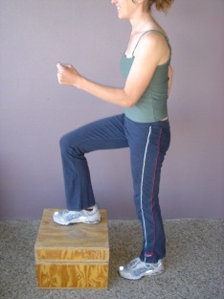
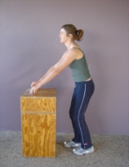
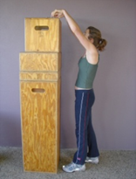
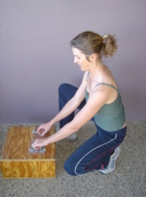
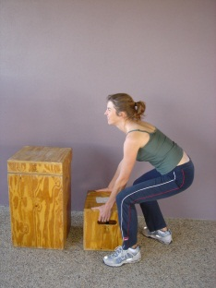
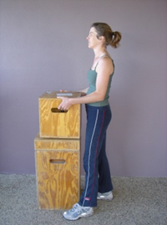
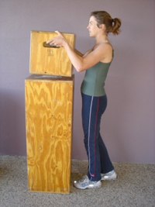
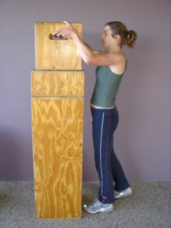
What is a JobFit System PEFA
PEFA (Pre-Employment Functional Assessment)
= job specific short form functional capacity evaluation that measures a person’s capacity to perform work at that time
Good to Excellent Reliability demonstrated
(Legge & Burgess-Limerick, 2007)
Overall PEFA score between 1 (met job demands) and 4
Notes:
The assessment tool that I have developed is the JobFit System PEFA. It is a job-specific short-form FCE consisting of a musculoskeletal screen, aerobic fitness test and job-specific postural and dynamic tolerances and material handling. Some of the components are based on the WorkHab FCE and have been modified with their permission. The scoring system is specific to the tool.
The PEFA assessment criteria are based on the inherent requirements of the job to meet anti-discrimination legal requirements and provide useful information. These have been obtained via an onsite task analysis using the JobFit System software.
The PEFA is an assessment conducted by a therapist, trained in the standardised JobFit System PEFA method. Previous scientific research has demonstrated Good to Excellent Reliability.
Assessments take about an hour and there are clearly defined safety protocols.

Slide 8
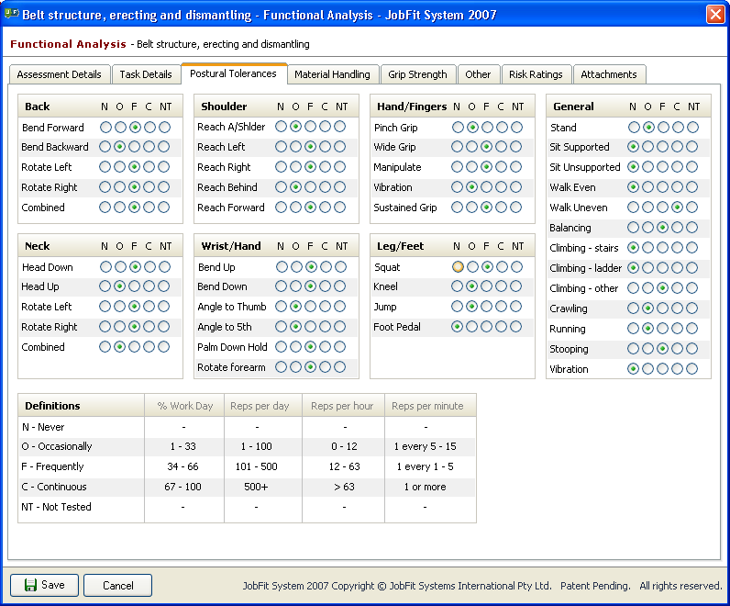
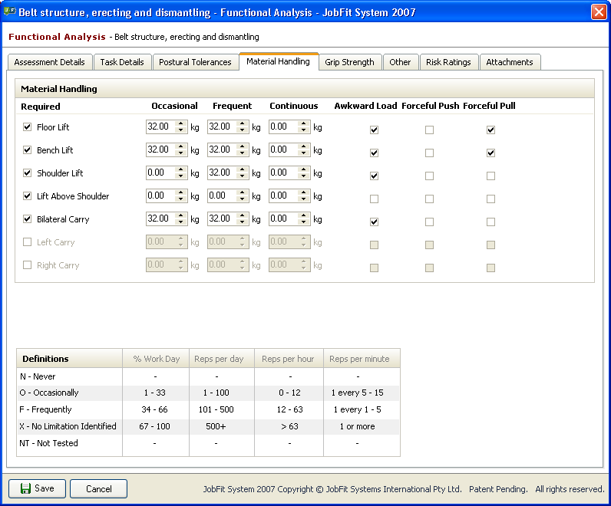
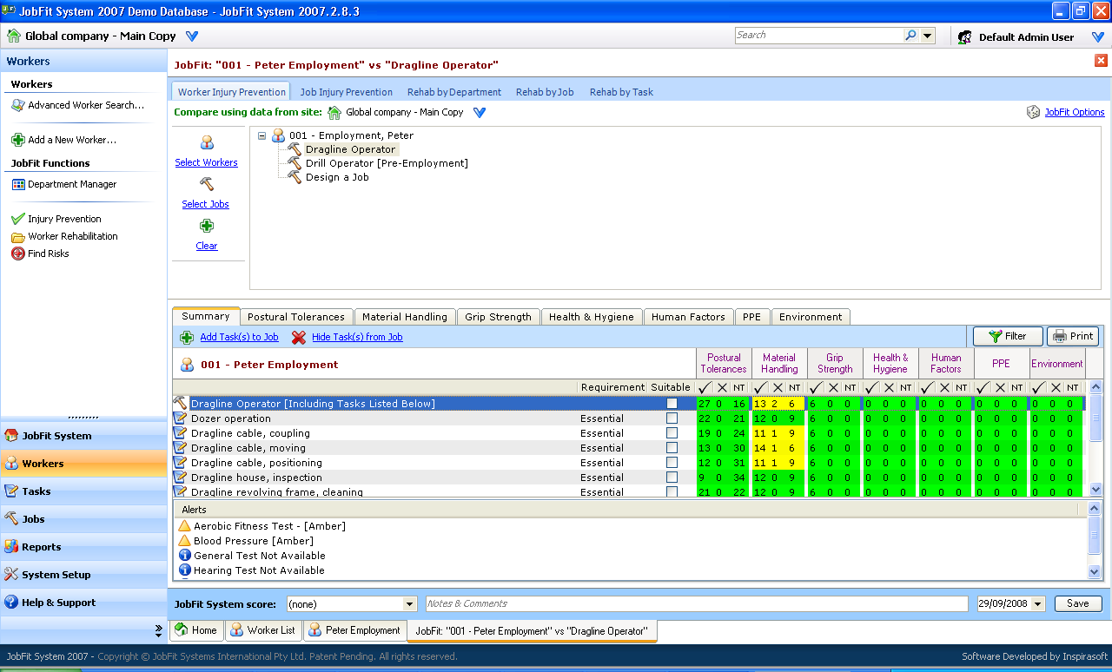
Talking the same language
Notes:
Assessment results are entered into the database using the same language as the task analysis and are then compared to the job demands using the software and workers are scored a 1 if they meet the job demands, 2 for minimal restrictions, 3 for moderate restrictions and 4 for a gross mismatch.
These assessments are being used in mining, manufacturing, utilities, construction, transport and security.
The question is though - are pre-employment functional assessments predictive of musculoskeletal injury risk?

Slide 9
Examining the evidence
Question
Are pre-employment functional assessments (PEFA) predictive of musculoskeletal injury risk?
Design
Prospective cohort study
Participants
Healthy male coal miners who had participated in job-specific PEFA and were employed in the job tested
Participants
Injuries
PEFA
Notes:
This research project is a prospective cohort study investigating the relationship between performance in a job-specific pre-employment functional assessment and subsequent sprains and strains in the workplace in healthy male coal miners.
As part of the recruitment process of the test site, all prospective employees between 2002 and 2009 were invited to participate in a PEFA. PEFA records were collected at the time of assessment. Overall PEFA scores were compared to worker age, department, occupation and length of employment.
Sprains and strains injury statistics were collected retrospectively from the company’s incident database. PEFA scores were compared to injury type, body location and mechanism of injury.

Slide 10
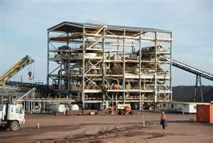
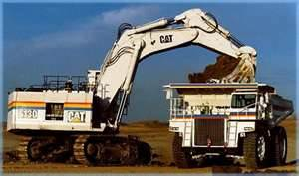
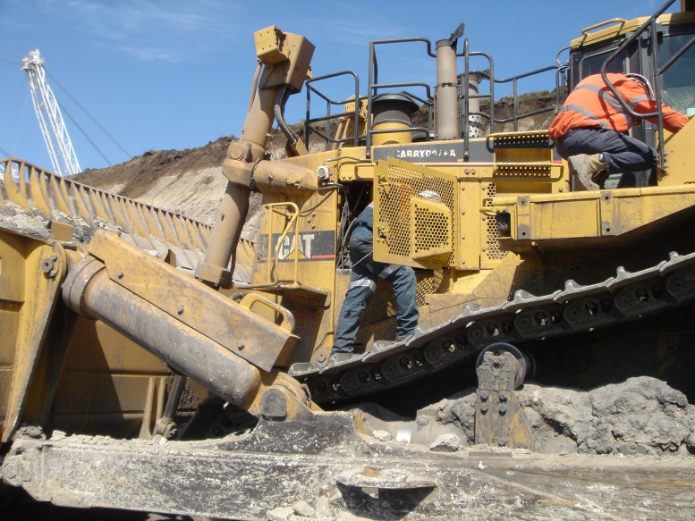
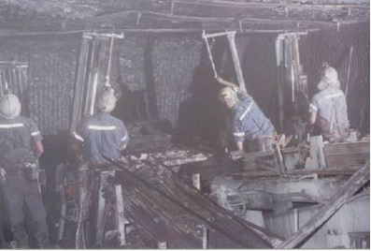
CHPP n=20, PEFA>1=70% Open Cut n=285, PEFA>1=15%
Study Group: n=600
Age at time of PEFA: 37.3 yrs (SD 10.2; range 17.1-62.6)
Tenure during study : Mean 2.7 yrrs (SD 2.1)
PEFA score: 427 scored 1,107 scored 2, 66 scored 3 (PEFA >1 total 173=29%)
Workshop n=95, PEFA>1=31% Professional n=61, PEFA>1=3% Underground n=139, PEFA>1=60%
Notes:
During the study period, 1019 PEFAs were conducted at the test site. Excluding females and workers who were not employed, 600 were employed in the job they were tested for and were included in the study.
427 met the job demands and scored 1. Due to the small numbers, workers who scored 2 or 3, were collapsed into one group, called PEFA >1. Overall, 29% of participants did not meet the job demands.
A significant association between PEFA score and Age or Tenure was not found.
There was however a significant association with Department and Occupation, with workers from the CHPP and UG, or Labourers and Tradespersons, most likely not to meet the job demands. This is probably due to the higher job demands in these work areas rather than a reduced physical capacity of these groups.

Slide 11
PEFA score and injury risk
Injury Type | PEFA 1 (%) | PEFA >1 (%) | RR (95% CI) | Adj.HR <=1.3 yrs (95% CI)* | Adj. HR 1.3 to 6 yrs (95% CI)*
Any injury | 71 (20) | 50 (40) | 1.7 (1.3 to 2.4) | 1.3 (0.7 to 2.1) | 2.3 (1.4 to 3.9)
Any manual handling injury | 27 (7) | 25 (17) | 2.3 (1.4 to 3.8) | 0.9 (0.4 to 2.1) | 3.3 (1.6 to 7.2)
Any back injury | 33 (8) | 23 (15) | 1.7 (1.0 to 2.8) | 0.6 (0.2 to 1.8) | 3.3 (1.6 to 6.6)
Any back injury from manual handling | 13 (3) | 16 (10) | 3.0 (1.5 to 6.2) | 0.9 (0.3 to 3.2) | 5.8 (2.0 to 16.7)
RR=Relative Risk; Adj HR=Adjusted Hazard Ratio * Adjusted for Department
Notes:
196 musculoskeletal injuries were reported by 121 workers. Back injuries were the most common by body location (43 injuries per 1000 person years) and manual handling injuries were the most common by mechanism of injury (46 injuries per 1000 person years). Back injuries from manual handling were the largest subgroup. The injury distribution of the research group was consistent with that of the Queensland mining industry, and the Australian working population in general.
For the analysis, the injuries were divided into four main injury types - any injury, any manual handling injury, any back injury, and any back injury from manual handling.
A significant increase in risk exists for workers who scored PEFA >1 for any of the four injury types with workers who did not meet the job demands three times more likely to have a back injury associated with manual handling than those who did meet the job demands.
We then looked at whether the risk changed over time. When we took into account time, and department (remember we identified increased risk in some departments), we found that there was a difference in risk over time, with no significant increase in injury risk in the first 1.3 years, BUT after that, it increased exponentially to 2.3 times for any injury, 3.3 times for any manual handling injury or back injury, and 5.8 times for any back injury from manual handling.
So, workers who did not meet their job demands in their initial assessment, and remained employed after 1.3 years, were 5.8 times more likely to have a back injury from manual handling!!!!

Slide 12
The ‘Honeymoon’ doesn’t have to end
Notes:
Let’s review the time factor. This study identified what could be described as an initial ‘honeymoon period’ after which time the participant’s risk of injury increased exponentially.
Further research is needed to attempt to determine the reason why this increased risk occurs,
however possible hypotheses include:
increased rate of musculoskeletal deterioration as a result of working at maximum capacity for an extended period;
decreased worker and / or employer awareness of, or compliance with, restrictions advised at the time of testing or commencement of employment;
further deconditioning from inactivity or other factors;
or, behavioural change of the worker toward more risk-taking activities on the assumption that “they had ‘survived’ thus far and therefore the predictions were wrong”.
Until such evidence is identified, health professionals, workers and employers can maximize the opportunity of the ‘honeymoon period’ as a time for physical conditioning, behavioural safety programs and workplace modifications in an attempt to proactively reduce the worker’s risk of injury rather than the negative option of not hiring.

Slide 13
Bringing it together
Notes:
I’ve spoken about my research in healthy workers. So we can apply these principles not just in the pre-employment phase but also, because it is a reliable tool, we can repeat the testing during the course of employment as part of a wellness program and ongoing monitoring. We can also apply it to injured workers during the course of their rehab, and at the end before returning to work. Even though an injury is classified as ‘stable and stationary’ and the claim is closed, further conditioning may still be required. Research by Doug Gross and colleagues in Canada, who are investigating the validity of short-form FCEs for rehab, found that worker and therapist confidence was the same as if they had done a full FCE, and RTW outcomes were the same. The only difference was with the cost being a third less. Short-form FCEs really are a practical method for measuring a worker’s change in capabilities over time.
When implementing such a program, I always recommend to employers to do it in phases. The rate at which an employer progresses through the phases depends on the maturity and culture of their organisation. Start with pre-employment and post rehab. It’s easy to draw those lines in the sand. Then introduce periodic assessments on a voluntary basis as part of your wellness program. Then once you have made the decision to make them a regular part of your wellness programs, because of the results that you have been seeing, give people a grace period to come in and do an assessment to find out where they are at. They can then work on improving themselves before the required testing comes in. These evolutionary steps will help to ensure that your program is received in the manner in which you intended – and that is to improve the health and wellness of your workforce, so that you will be their employer of choice. Because you have helped them to achieve better health.

Slide 14
Notes:
You will of course need stakeholder buy in and everyone will have their own agendas.
For each of the stakeholder groups, table their concerns and then ensure that you find a benefit, that was meaningful to them, that outweighs their concerns.
No one wants to be the last to know but someone has to be first. There is a very tight balancing act of the order and manner in which you communicate to your stakeholders initially and then in an ongoing basis.
Remember to also broadcast the outcomes of your project, the successes and the challenges. Once people have buy-in they also become committed to the success of the project and assisting you to overcome your challenges.

Slide 15
Notes:
So, it’s pretty obvious to most of us that if we try to place a worker into a job that they are not suitable for, whether that is pre-employment or during a RTW program or post rehab … someone is going to be hurt.
Task analysis is one part of the process. Worker assessments are another part of the process. I’ve only spoken about the physical components today and as we all know, there are so many other factors in successfully placing a healthy or injured worker into a role.

Slide 16
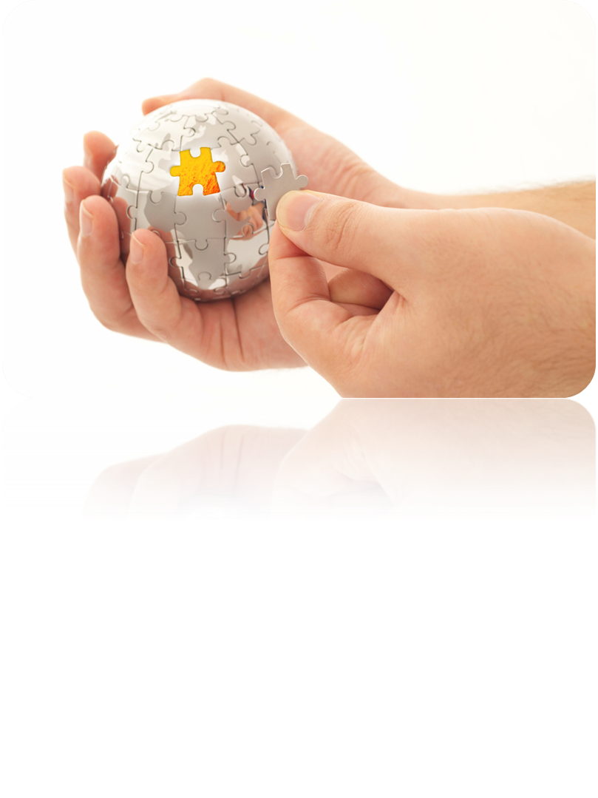
For more info
Jenny Legge
jenny.legge@jobfitsystem.com
www.jobfitsystem.com
Notes:
This is just one piece of the puzzle of fitting workers to jobs and jobs to workers. It is only one. But it is a very useful one.
Just to finish, raise your hands in the air. Leave them there if you are going to be a pig and make a long term commitment to change, or lower them if you are going to be a chicken. ☺
Thank you.

