Slide 1
Marketing and Education Subcommittee Report
ASIEQ Forum
14th February 2013

Slide 2
Q-COMP – Conference in Cairns
ASIEQ is a
SILVER Sponsor
for Q-COMP’s
North Queensland Return to Work Conference & Expo on the
22 March 2013
Notes:
Note – We won’t be having a booth at the conference – the sponsorship is just part of the relationship build with Q-Comp in recognition of the support for the EBIM conference.

Slide 3
2013 ASIEQ Events Calendar
Note – Message Improving Workplace Culture by creating and delivering
Better Business Practices
Links to ASIEQ’s 5 Core messages and the EBIM Conference message.
Quantities have been distributed to members - small number are available for those who need more.

Slide 4
2013 EBIM Calendar
Thank you to
our sponsors
KINNECT STRIVE
&
MLCOA
Notes:
Note – There are a couple of hundred spare copies for those that are interested. Copies will be at the back of the room.
3 Sponsors who contributed to the development of the Calendar – 5000 Copies produced and distributed.

Slide 5
2013 EBIM Conference Update
6 Page Conference Brochure now released.
Your assistance in promoting the conference
would be greatly appreciated .
Conference early bird rate extended until 28th February
Notes:
Each Member will be sent 20 Copies and assistance in gathering support would be appreciated.

Slide 6
Conference Program Available
More Information
about the presenters
can be found on
the website
www.injurymangement2013.com
Notes:
Need to Promote – Presenters from around Australia, update in regards to Workers Compensation review

Slide 7
PIEF – Cert 4 Personal Injury Management
Closing dates have for enrolments in Cert 4 in PIM Courses have been extended to
22 February - Check out www.pief.com.au
Cert 4 Return to Work and Cert 4 Claims Management

Slide 8
New ASIEQ Website
Still some updating required, it may have formatting issues
in some older versions of Internet Explorer. Appreciate feedback.

Slide 9
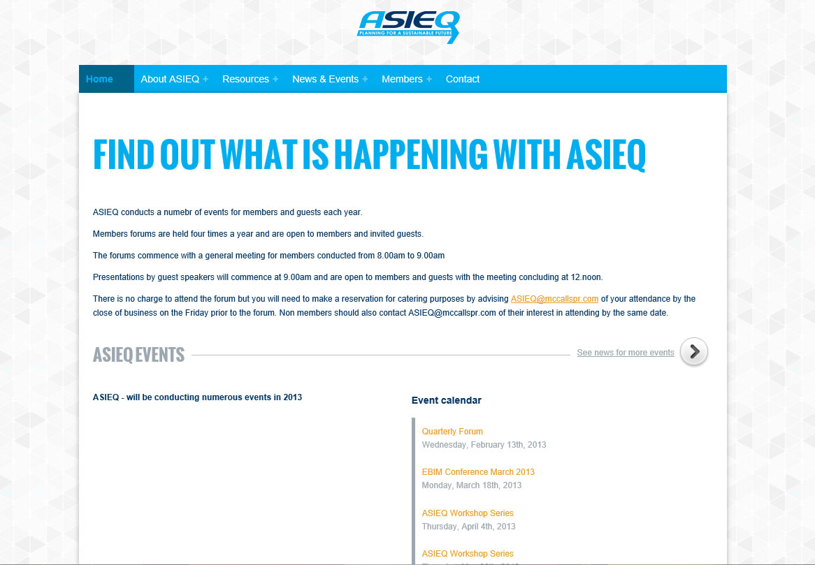
Need Help to Keep News Current
Please forward items of interest to Neil at McCalls

