Slide 1
Marketing and Education Subcommittee Report
ASIEQ Forum
8th May 2013

Slide 2
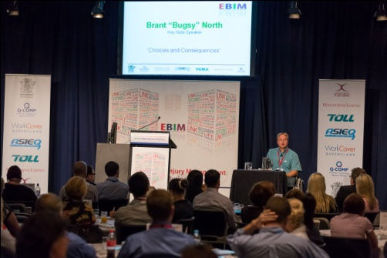
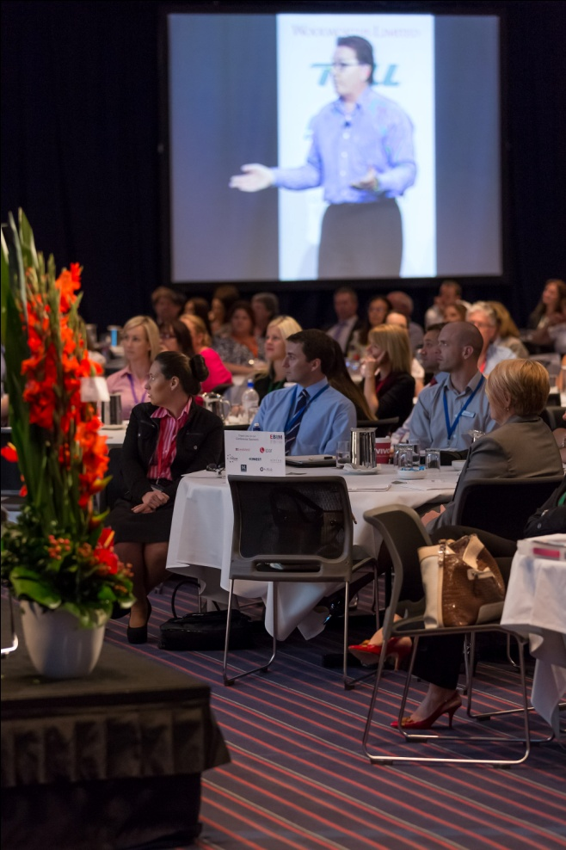
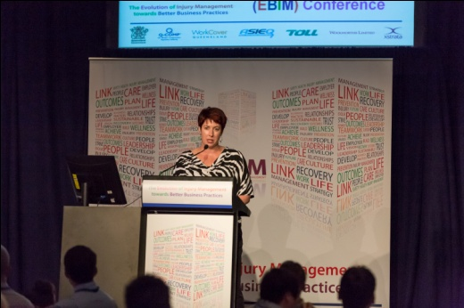
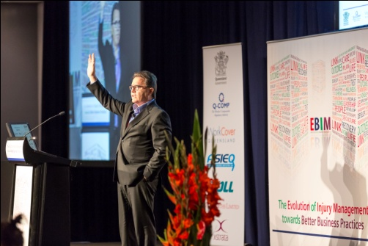
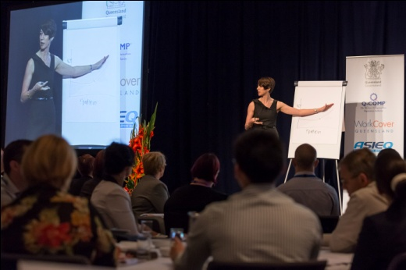
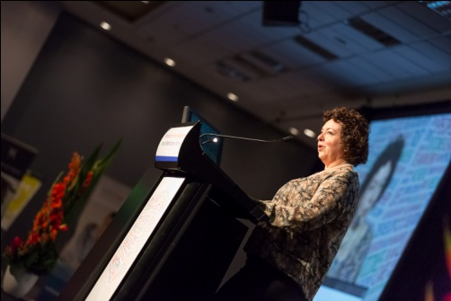
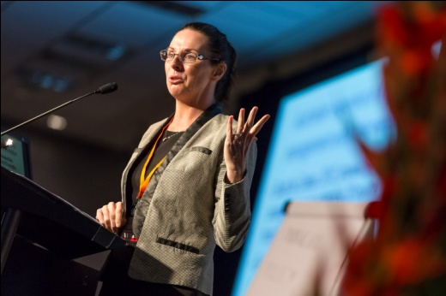
2013 EBIM Conference
.
Highly successful conference once again promoting ASIEQ as a leading stakeholder.

Slide 3
Conference focused on Better Business Practices

Slide 4
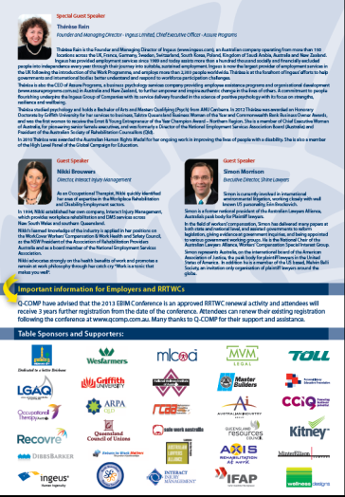
Conference Outcomes
Paying Attendees 287
Name Tags Produced 350
Seating per Day 320
Income $218,000
Expenditure $193,000
Surplus $25,000
Less possible Tax $8,000
Balance to Marketing & Education $17,000
Notes:
Each Member will be sent 20 Copies and assistance in gathering support would be appreciated.

Slide 5
2014 EBIM Calendar
Development of the 2014 Employer
Based Injury Management
Calendar –
Currently seeking interest before final Commitment
Notes:
Note – There are a couple of hundred spare copies for those that are interested. Copies will be at the back of the room.
3 Sponsors who contributed to the development of the Calendar – 5000 Copies produced and distributed.

Slide 6
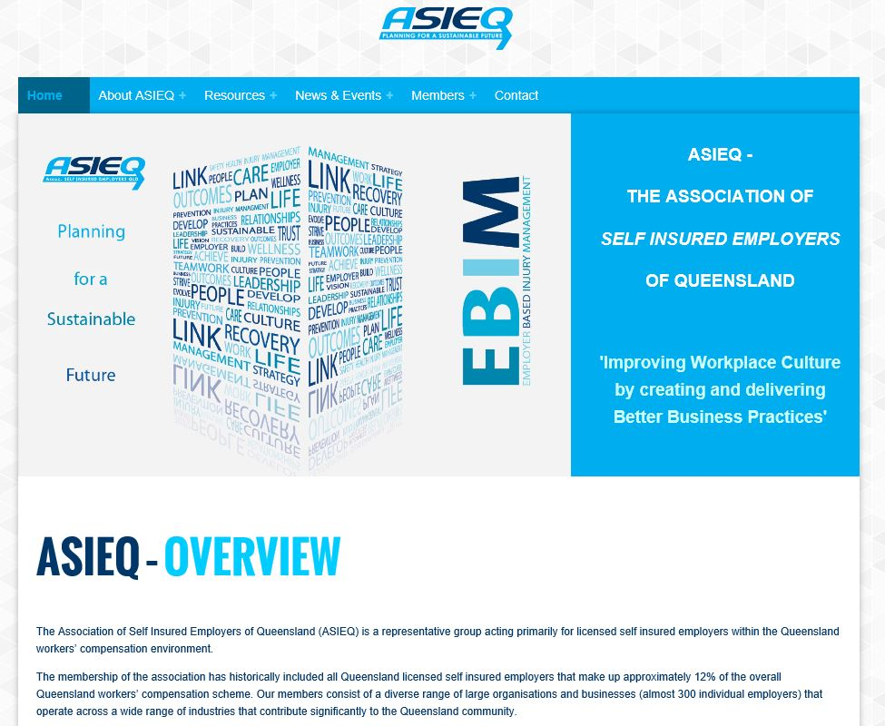
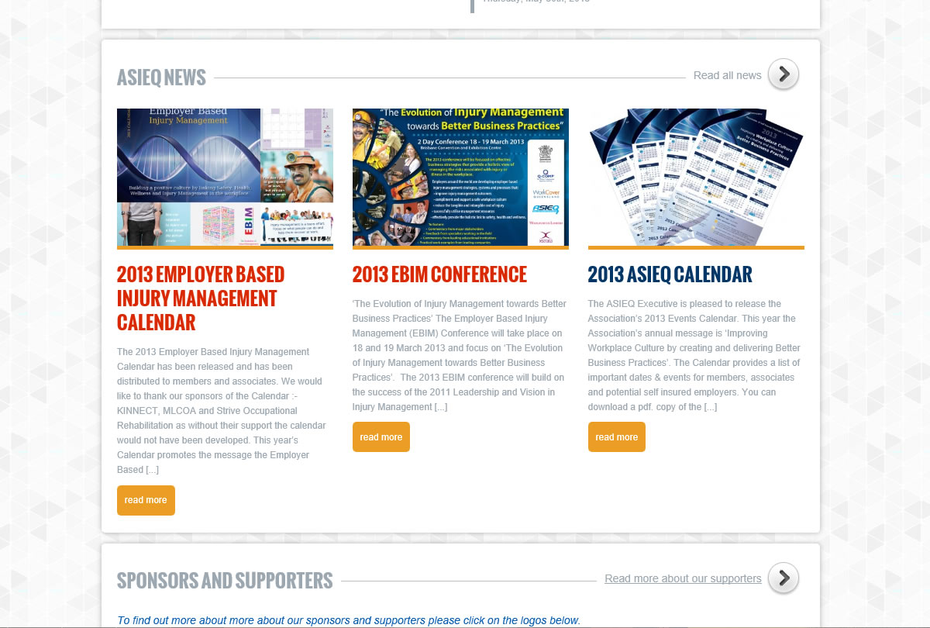
New ASIEQ Website
Now operating in various versions of internet explorer.
Design allows easy access for mobile phone users

Slide 7
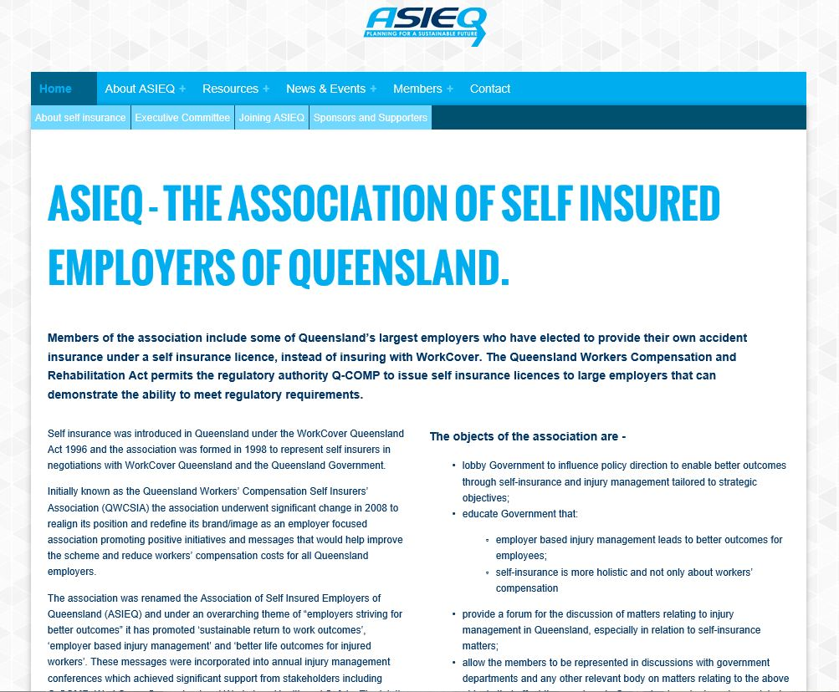
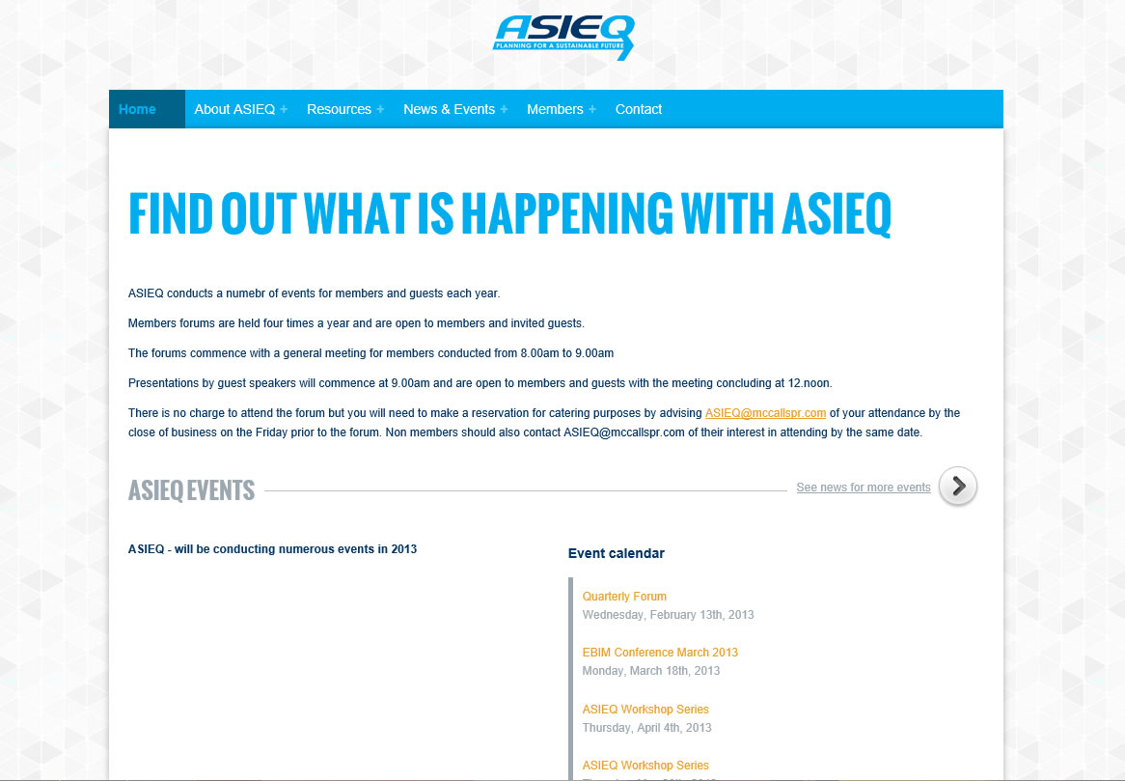
Need help to keep news current
Please forward items of interest to Neil at McCalls

Slide 8
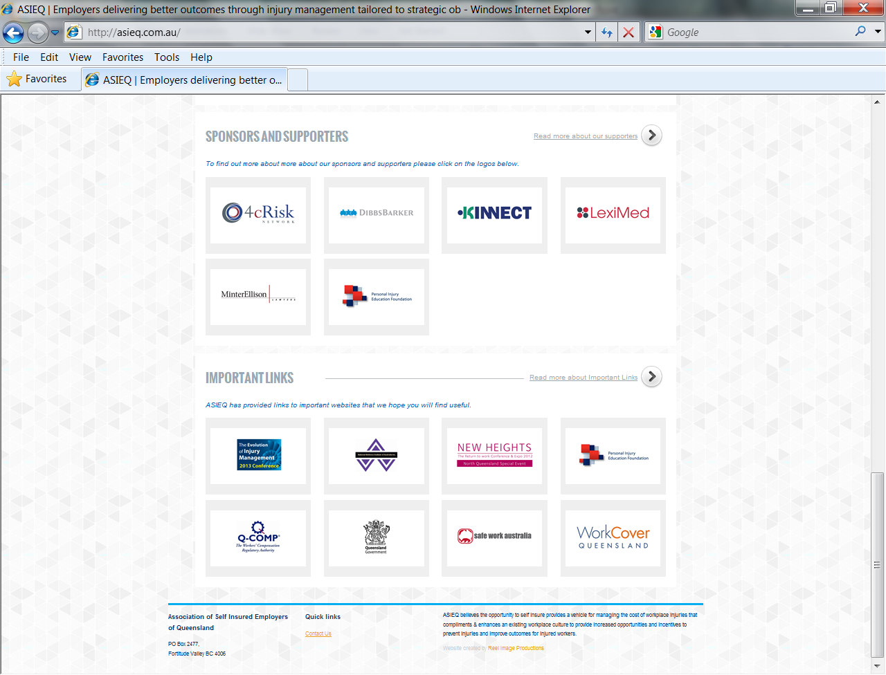
Website Sponsorship
Sponsorship to be renewed in conjunction
with annual membership fees
Require sponsors for Website to cover
Annual operating Costs – Need to introduce
fee for advertising provider events

Slide 9
Long Service Leave
Bill has now reached 10 Years on the Executive and is stepping down from the Marketing and Education Sub Committee
Currently resolving outstanding issues and will allocate provisions to ensure finances are set aside to ensure certain activities will have funds to proceed until the next conference.
Allocation 1 - $30, 000 to be allocated as seed money for 2015 conference
Allocation 2 - $5,000 allocate to 2014 & 2014 A4 Calendar
Further allocations to be determined once Q-COMP sponsorship
and Board Room lunch costs have been paid. Also budget will need to be
set for the 2014 Employer Based Injury Management Calendar .

