Slide 1
Presentation:
THE ANATOMY OF AN IME
Presenter:
DR BOB IVERS
ORTHOPAEDIC SURGEON, CIME

Slide 2
Why do we need to talk about how to conduct an IME?
Episode of great anxiety for some examinees.
Many examinees have a parallel psychosocial complaint.
Many feel aggrieved before they arrive.
Claims may be protracted.
The desired surgical outcome may be elusive.
Uptick in the number of “made worse” claims according to lawyers.
No need for any confrontation.
We are starting out with a disadvantage.
The process is becoming more sophisticated and complex.
The Anatomy of an IME

Slide 3
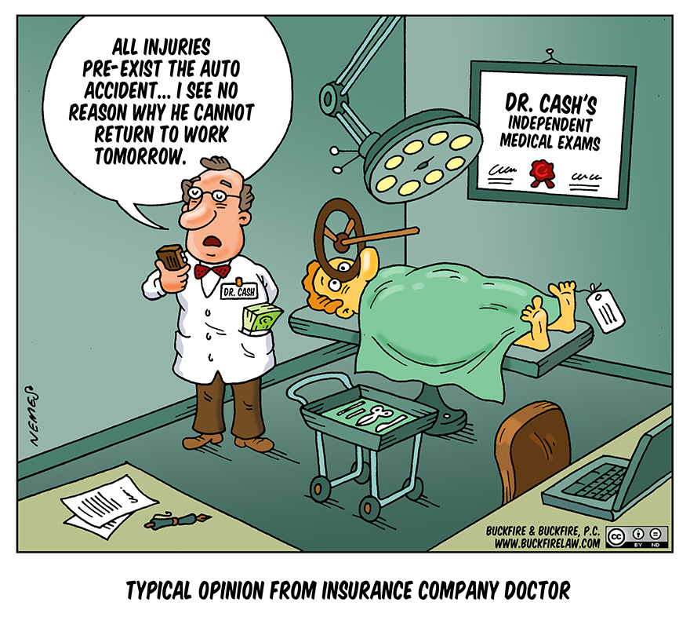
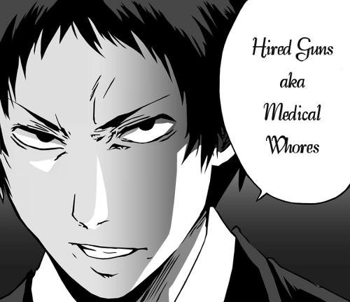
Disconnect between what is feared and what actually happens
The Anatomy of an IME

Slide 4
Need to avoid Bias
Inclination or prejudice for or against one person or group, especially in a way considered to be unfair.
An apprehension of bias: the test is; would a fair-minded and informed member of the public apprehend that you might not approach your task with the required impartiality.
The Anatomy of an IME

Slide 5
What is an IME?
Not a standard medical consultation.
No doctor patient relationship established.
Alteration in the expected outcome – claim finalised/loss of income, apparent restriction of treatment.
Change in the power structure. Examinee is empowered.
The examiner is at increased risk.
There are several parties involved.
Need to re-think the process to produce mutual fairness.
The Anatomy of an IME

Slide 6
Tensions
Insurer/
client
Law
Employer
Examinee
The Anatomy of an IME

Slide 7
Desired outcome
Happy examinee fair and no bias
No made worse allegations
Happy client insurer, insuree
Happy medico ******
Good solid timely report
Can be defended
Reduced clarifications
The Anatomy of an IME

Slide 8
What can be done to achieve fairness and satisfaction?
1. Before the consultation.
2. During the consultation.
3. After the consultation.
The Anatomy of an IME

Slide 9
1. Before the consultation (me)
1. (a) Read the brief thoroughly. Make notes.
1 (b) Check the purpose of the report
Medical Examination?
Permanent Impairment?
Causation?
Medicolegal?
1 (c) Check the jurisdiction.
1. (d) Allow time.
1. (e) Obtain relevant training AMA, GEPI, DVA, Commonwealth.
The Anatomy of an IME

Slide 10
1. Before the consultation (client, you)
1. (a) Prepare the brief and letter of instruction.
1. (b) Educate the examinee.
1. (c) Explain the process.
1. (d) Emphasise aspects important to the examiner:
Punctuality
Prepare psychologically
Bring relevant information
Bring a support person if necessary
Underwear is not optional
The Anatomy of an IME

Slide 11
1. (a). Prepare the brief and letter of instruction (Client)
Ensure the information is available.
Radiology reports.
Treating professional reports GP notes etc.
Avoid duplication.
Logical order.
Relevant claim number.
Be clear as to what is required from the report.
Has the condition been accepted? Causation??
What aspect of the injury or condition must be addressed?
Any specific questions? Ensure the questions are not a repeat of the previous questions.
The Anatomy of an IME

Slide 12
1. (b) Educate the examinee (Client)
Non confrontational process.
Purpose is to assist with the management of the claim.
No treatment advice will be offered and do not seek it.
Bring all relevant information including radiology.
Think about the likely questions:
How did the injury occur?
When did it occur?
What treatment have you had?
Ok to bring a support person.
The Anatomy of an IME

Slide 13
1. (c) Explain the process (IME)
Reception staff.
Reduce examinee anxiety.
Comprehensive consent form.
Role of the examiner
Role of chaperone
Aim is to gain information but not make worse
Audiotape
Permission to seek online radiology
The Anatomy of an IME

Slide 14
Independent Medical Examination and Report Dr Robert Ivers Orthopaedic Surgeon.
PATIENT ATTENDANCE & CONSENT CONFIRMATION
I,……………………………………………………..confirm that I attended an independent medical assessment with Dr Ivers
on ………../………./……….
I understand that I am being assessed by Dr Ivers for the purposes of the doctor writing a report for the referring client (for example WorkCover / Insurer) who requested that I attend the examination.
I acknowledge and agree that Dr Ivers will not be treating me. I understand that the information that I discuss will be included in a report being sent to this client.
I consent to undergoing the assessment by the doctor, including any necessary history taking, physical examination, and reasonable tests including radiography. If female, I consent to having a female chaperone present during the clinical examination.
I agree that for quality and accuracy purposes the consultation may be tape recorded. If I do not wish to have the consultation tape-recorded, I will notify Dr Ivers at the beginning of the consultation. I acknowledge that a copy of the audiotape will be available to me, or my legal representatives, on request.
The Anatomy of an IME

Slide 15
I agree to the obtaining of photographic identification.
Whilst the nature of the clinical examination demands that I exhibit the best movement possible, as requested, I agree that I will advise Dr Ivers immediately if I experience any difficulties during the examination, or if a certain test is causing too much discomfort. I understand that some pain, stiffness or other symptoms are produced in most physical examinations of this sort, for instance when touching a tender spot or checking how far a stiff joint can move, and such findings are helpful in understanding my condition.
I give permission to Dr Ivers to view any radiographs which may be made available electronically by radiology providers.
Signed………………………………………………
Dated………./………./……….
Witness…………………………………………….
The Anatomy of an IME

Slide 16
The consent form is the key
Use as an educational tool
Provide information
Construct a defensive wall
The Anatomy of an IME

Slide 17
Chaperone
I consent to undergoing the assessment by the doctor, including any necessary history taking, physical examination, and reasonable tests including radiography. If female, I consent to having a female chaperone present during the clinical examination.
The Anatomy of an IME

Slide 18
Audiotape
I agree that for quality and accuracy purposes the consultation may be tape recorded. If I do not wish to have the consultation tape-recorded, I will notify Dr Ivers at the beginning of the consultation. I acknowledge that a copy of the audiotape will be available to me, or my legal representatives, on request.
The Anatomy of an IME

Slide 19
Audiotape
Controversial.
Not all jurisdictions approve.
Quality and accuracy.
Defence against allegations.
Encourage examiner to be nice.
Encourage logic and completeness.
The Anatomy of an IME

Slide 20
“Made worse”
Whilst the nature of the clinical examination demands that I exhibit the best movement possible, as requested, I agree that I will advise Dr Ivers immediately if I experience any difficulties during the examination, or if a certain test is causing too much discomfort. I understand that some pain, stiffness or other symptoms are produced in most physical examinations of this sort, for instance when touching a tender spot or checking how far a stiff joint can move, and such findings are helpful in understanding my condition.
The Anatomy of an IME

Slide 21
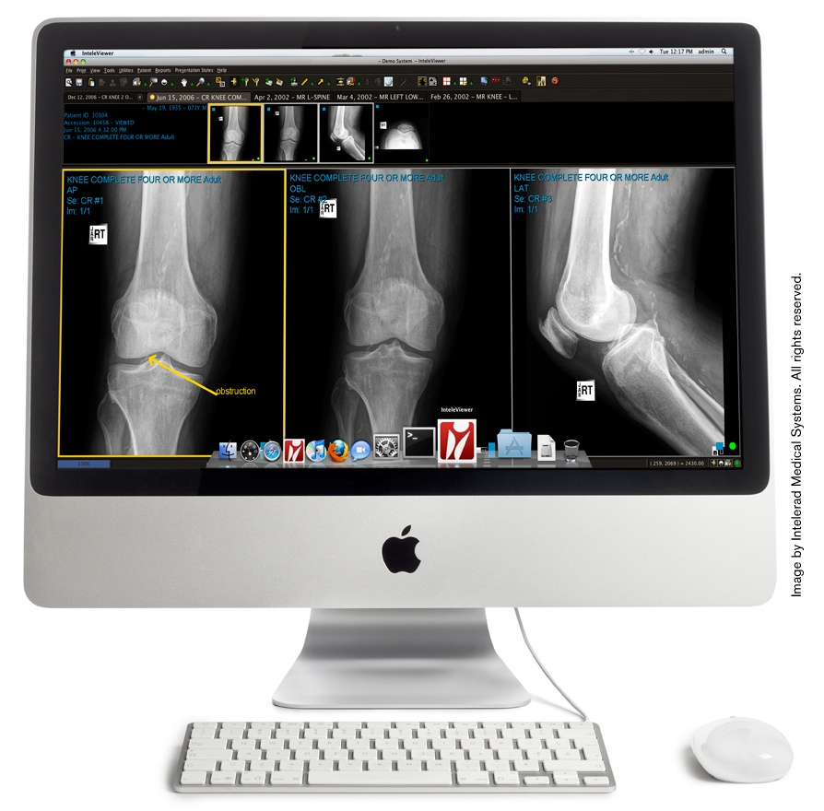
Electronic radiographs
I give permission to Dr Ivers to view any radiographs which may be made available electronically by radiology providers.
The Anatomy of an IME

Slide 22
Pain disability questionnaire PDQ
The Anatomy of an IME

Slide 23
1. Does your pain interfere with your normal work inside and outside the home?
Work normally Unable to work at all
0 -------- 1 --------2 --------3 --------4 -------- 5 -------- 6 --------7 -------- 8 -------- 9 -------- 10
2. Does your pain interfere with personal care (such as washing, dressing, etc.)?
Take care of myself completely Need help with all my personal care
0 -------- 1 --------2 --------3 --------4 -------- 5 -------- 6 --------7 -------- 8 -------- 9 -------- 10
3. Does your pain interfere with your traveling?
Travel anywhere I like Only travel to see doctors
0 -------- 1 --------2 --------3 --------4 -------- 5 -------- 6 --------7 -------- 8 -------- 9 -------- 10
4. Does your pain affect your ability to sit or stand?
No problems Can not sit/stand at all
0 -------- 1 --------2 --------3 --------4 -------- 5 -------- 6 --------7 -------- 8 -------- 9 -------- 10
5. Does your pain affect your ability to lift overhead, grasp objects, or reach for things?
No problems Can not do at all
0 -------- 1 --------2 --------3 --------4 -------- 5 -------- 6 --------7 -------- 8 -------- 9 -------- 10
6. Does your pain affect your ability to lift objects off the floor, bend, stoop, or squat?
No problems Can not do at all
0 -------- 1 --------2 --------3 --------4 -------- 5 -------- 6 --------7 -------- 8 -------- 9 -------- 10
The Anatomy of an IME

Slide 24
7. Does your pain affect your ability to walk or run?
No problems Can not walk/run at all
0 -------- 1 --------2 --------3 --------4 -------- 5 -------- 6 --------7 -------- 8 -------- 9 -------- 10
8. Has your income declined since your pain began?
No decline Lost all income
0 -------- 1 --------2 --------3 --------4 -------- 5 -------- 6 --------7 -------- 8 -------- 9 -------- 10
9. Do you have to take pain medication every day to control your pain?
No medication needed On pain medication throughout the day
0 -------- 1 --------2 --------3 --------4 -------- 5 -------- 6 --------7 -------- 8 -------- 9 -------- 10
10. Does your pain force your to see doctors much more often than before your pain began?
Never see doctors See doctors weekly
0 -------- 1 --------2 --------3 --------4 -------- 5 -------- 6 --------7 -------- 8 -------- 9 -------- 10
11. Does your pain interfere with your ability to see the people who are important to you as much as you would like?
No problem Never see them
0 -------- 1 --------2 --------3 --------4 -------- 5 -------- 6 --------7 -------- 8 -------- 9 -------- 10
12. Does your pain interfere with recreational activities and hobbies that are important to you?
No interference Total interference
0 -------- 1 --------2 --------3 --------4 -------- 5 -------- 6 --------7 -------- 8 -------- 9 -------- 10
The Anatomy of an IME

Slide 25
13. Do you need the help of your family and friends to complete everyday tasks (including both work outside the home
and housework) because of your pain?
Never need help Need help all the time
0 -------- 1 --------2 --------3 --------4 -------- 5 -------- 6 --------7 -------- 8 -------- 9 -------- 10
14. Do you now feel more depressed, tense, or anxious than before your pain began?
No depression/tension Severe depression/tension
0 -------- 1 --------2 --------3 --------4 -------- 5 -------- 6 --------7 -------- 8 -------- 9 -------- 10
15. Are there emotional problems caused by your pain that interfere with your family, social and or work activities?
No problems Severe problems
0 -------- 1 --------2 --------3 --------4 -------- 5 -------- 6 --------7 -------- 8 -------- 9 -------- 10
________________________________________
Examiner
OTHER COMMENTS:
________________________________________________________________________________________________
With Permission from: Anagnostis C et al: The Pain Disability Questionnaire: A New Psychometrically Sound
Measure for Chronic Musculoskeletal Disorders. Spine 2004; 29 (20): 2290-2302.
The Anatomy of an IME

Slide 26
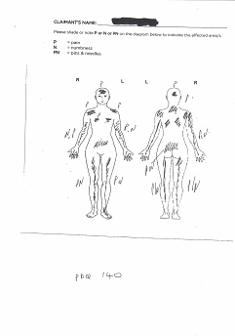
PDQ
Functional assessment instrument designed for evaluating chronic disabling musculoskeletal disorders.
Assesses function/disability as affected by pain.
There is a predictive validity of the PDQ in its relationship to 1-year post-treatment work- and health-related outcome.
Incorporated into AMA 6.
Often correlates with the pain diagram.
0 No disability
1-70 Mild disability
71-100 Moderate disability
101-130 Severe disability
131-150 Extreme disability
The Anatomy of an IME

Slide 27
During the consultation
Allow adequate time *******
Clear explanation of the roles.
Use a template for completeness.
Be prepared for compromise.
Be logical and complete.
The Anatomy of an IME

Slide 28
During the consultation: Useful terms
“Need to understand what has happened”.
“And how it affects you”.
“We have been brought together to assist with……”.
“Offer a snap shot of how you are on this day.”
“Need to see the best movement/strength that you can muster.”
“Do not do a movement if it is likely
to cause you pain.”
The Anatomy of an IME

Slide 29
After the consultation
Information overload.
The end of the consultation is most vulnerable period.
No gratuitous comments.
Reception staff.
Exit satisfaction form?
Timely report.
The Anatomy of an IME

Slide 30
Desired outcome
Happy examinee fair and no bias.
No made worse allegations.
Happy client ********.
Happy medico.
Good solid timely report.
Can be defended.
Reduced clarifications.
The Anatomy of an IME

Slide 31
Questions?
The Anatomy of an IME

Slide 32
Thank you.
The Anatomy of an IME

