Slide 1
Matthew Bannan
Industry Manager Customer Experience
ASIEQ forum
Wednesday 09 November 2016

Slide 2
Musculoskeletal injuries campaign
What are we setting out to achieve?
The musculoskeletal injuries campaign commenced on 26 April 2016 and will run for 12 months.
The objective of the campaign is to reduce musculoskeletal injuries by five (5) per cent across all industry sectors in 12 months.
We also aim to increase employer and worker awareness and knowledge in the following areas:
common injury triggers
workplace design
safe talk and action (how to communicate safety and the importance of return to work)
work your recovery (return to work topics, including suitable duties, Recover at Work host employment program, rehabilitation tips and advice).
Throughout the campaign, WorkCover will again develop, collate and prepare various material that could be shared with our customers experiencing musculoskeletal injury claims and who will benefit from the information/resources.
.
Together with individual claims data, our Customer Services people used this information to start a conversation with their relevant customers and educate them on how to prevent musculoskeletal injuries in their workplace.
Notes:
Untreated mental health conditions are costing Australian employers over $10 billion annually through absenteeism, reduced productivity and workers’ compensation claims, according to 2014 PricewaterhouseCoopers Australia (PwC) research.
Whilst this is a significant cost, Queensland businesses can take heart knowing that investing in mental health action plans can pay dividends. The PwC research Creating a mentally healthy workplace—Return on investment analysis, was conducted for beyondblue and the National Mental Health Commission and suggests businesses can earn a $2.30 return on investment for every dollar they spend on managing mental health.
That’s why managing and preventing mental health problems in the workplace makes sense commercially and benefits worker wellbeing.
WorkCover received over 3,700 mental health claims in 2014-2015 and paid out over $45 million in compensation costs. Workers with mental health claims took on average 91 days off work; over three times longer than any other injury recovery timeframe.

Slide 3
Musculoskeletal injuries campaign
What will be the format of the campaign?
News articles on our website
Promotion via online services
Webinars and forums
Email templates
Social media articles and posts e.g. Facebook and Twitter
Notes:
Untreated mental health conditions are costing Australian employers over $10 billion annually through absenteeism, reduced productivity and workers’ compensation claims, according to 2014 PricewaterhouseCoopers Australia (PwC) research.
Whilst this is a significant cost, Queensland businesses can take heart knowing that investing in mental health action plans can pay dividends. The PwC research Creating a mentally healthy workplace—Return on investment analysis, was conducted for beyondblue and the National Mental Health Commission and suggests businesses can earn a $2.30 return on investment for every dollar they spend on managing mental health.
That’s why managing and preventing mental health problems in the workplace makes sense commercially and benefits worker wellbeing.
WorkCover received over 3,700 mental health claims in 2014-2015 and paid out over $45 million in compensation costs. Workers with mental health claims took on average 91 days off work; over three times longer than any other injury recovery timeframe.

Slide 4
Musculoskeletal injuries campaign
Articles to date
The 'Big 3' causes of musculoskeletal injuries - published 26 April 2016
Is there a safe way to lift? - published 19 May 2016
Four simple steps to prevent fall injuries - published 15 June 2016
What is good work design? - published 15 June 2016
How to minimise manual handling injuries - published 19 July 2016
Three myths about workplace injuries - published 19 July 2016
Tradies urged to keep a check on health and wellbeing (Tradies National Health Month) - published 3 August 2016
The Industrial Athlete - published 4 August 2016
Sports medicine tools to monitor injury risk - published 4 August 2016
Sports medicine 'team model' - published 4 August 2016
Risks for new workers - published 5 September 2016
Four steps to manage hazardous manual tasks - published 5 September 2016
The unique risk profile of young workers - published 2 November 2016
People handling injuries: Regularly re-assess client's needs for safe transfers - published 2 November 2016
Notes:
Untreated mental health conditions are costing Australian employers over $10 billion annually through absenteeism, reduced productivity and workers’ compensation claims, according to 2014 PricewaterhouseCoopers Australia (PwC) research.
Whilst this is a significant cost, Queensland businesses can take heart knowing that investing in mental health action plans can pay dividends. The PwC research Creating a mentally healthy workplace—Return on investment analysis, was conducted for beyondblue and the National Mental Health Commission and suggests businesses can earn a $2.30 return on investment for every dollar they spend on managing mental health.
That’s why managing and preventing mental health problems in the workplace makes sense commercially and benefits worker wellbeing.
WorkCover received over 3,700 mental health claims in 2014-2015 and paid out over $45 million in compensation costs. Workers with mental health claims took on average 91 days off work; over three times longer than any other injury recovery timeframe.

Slide 5
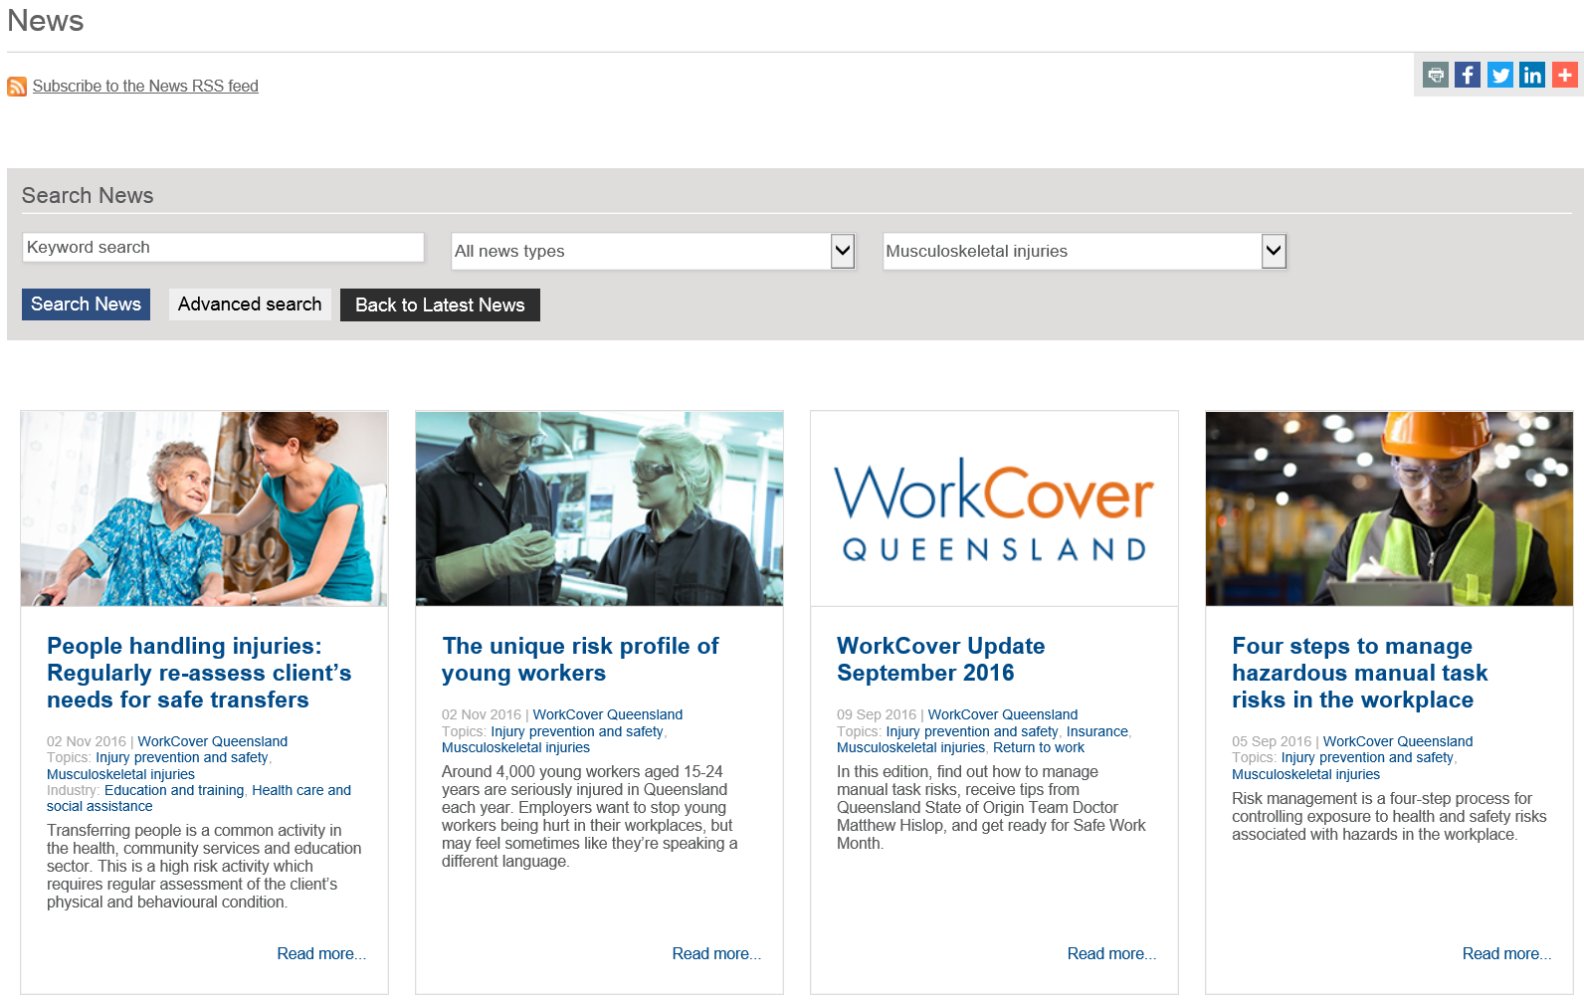
Musculoskeletal injuries campaign
To see all our musculoskeletal news articles on our website, go to https://www.worksafe.qld.gov.au/musculoskeletal
Upgraded News search function https://www.worksafe.qld.gov.au/news
Notes:
Untreated mental health conditions are costing Australian employers over $10 billion annually through absenteeism, reduced productivity and workers’ compensation claims, according to 2014 PricewaterhouseCoopers Australia (PwC) research.
Whilst this is a significant cost, Queensland businesses can take heart knowing that investing in mental health action plans can pay dividends. The PwC research Creating a mentally healthy workplace—Return on investment analysis, was conducted for beyondblue and the National Mental Health Commission and suggests businesses can earn a $2.30 return on investment for every dollar they spend on managing mental health.
That’s why managing and preventing mental health problems in the workplace makes sense commercially and benefits worker wellbeing.
WorkCover received over 3,700 mental health claims in 2014-2015 and paid out over $45 million in compensation costs. Workers with mental health claims took on average 91 days off work; over three times longer than any other injury recovery timeframe.

Slide 6
Prevention and Performance Initiative
https://www.worksafe.qld.gov.au/news/2015/workcover-queensland-launches-2015-prevention-and-performance-initiative
In July 2015, WorkCover launched its inaugural Prevention and Performance Initiative.
The aim was to improve safety within Queensland workplaces, reduce workplace injury claims and associated costs and improve return to work opportunities and outcomes for injured workers.
WorkCover contributed up to 75 per cent of the cost of a successful applicant’s initiatives up to a maximum value of $20,000.
Notes:
Untreated mental health conditions are costing Australian employers over $10 billion annually through absenteeism, reduced productivity and workers’ compensation claims, according to 2014 PricewaterhouseCoopers Australia (PwC) research.
Whilst this is a significant cost, Queensland businesses can take heart knowing that investing in mental health action plans can pay dividends. The PwC research Creating a mentally healthy workplace—Return on investment analysis, was conducted for beyondblue and the National Mental Health Commission and suggests businesses can earn a $2.30 return on investment for every dollar they spend on managing mental health.
That’s why managing and preventing mental health problems in the workplace makes sense commercially and benefits worker wellbeing.
WorkCover received over 3,700 mental health claims in 2014-2015 and paid out over $45 million in compensation costs. Workers with mental health claims took on average 91 days off work; over three times longer than any other injury recovery timeframe.

Slide 7
Prevention and Performance Initiative
Endeavour Foundation, a large multi-state employer, used funding under the WorkCover Queensland Prevention and Performance Initiative to successfully implement their ‘Injury Assist Hotline” program. This program utilised an external company who had an established network of medical providers and triage hotline to assist staff and managers in addressing injuries and illness in the workplace. The cost of implementing the program was $77,000.
In the seven month trial period, 51% of cases required self-management advice only; 43% required referral to a GP and 6% required emergency intervention. Of the cases referred to a GP, 49% elected to attend a network clinic, 34% opted to see their own GP and 17% had already made a GP appointment prior to contacting the IAH service.
Monthly lost time injury frequency rates have reduced between 30 to 54% across the pilot period, on the background of an ever-expanding business where FTE has grown by 12%. Further analysis is being conducted on the impact on claims costs and durations (and ultimately overall premium impact)
Endeavour have highlighted benefits beyond specific claim outcomes:
“The IAH has been a very successful initiative and is providing valuable medical assistance for our injured workers. The department that is having the best outcomes as a result of the initiative is Endeavour Industries, specifically the Supported Employees. This is due to the added level of support that can now be provided to the SE’s that can then also be handed on to their families and caregivers.”
Notes:
Untreated mental health conditions are costing Australian employers over $10 billion annually through absenteeism, reduced productivity and workers’ compensation claims, according to 2014 PricewaterhouseCoopers Australia (PwC) research.
Whilst this is a significant cost, Queensland businesses can take heart knowing that investing in mental health action plans can pay dividends. The PwC research Creating a mentally healthy workplace—Return on investment analysis, was conducted for beyondblue and the National Mental Health Commission and suggests businesses can earn a $2.30 return on investment for every dollar they spend on managing mental health.
That’s why managing and preventing mental health problems in the workplace makes sense commercially and benefits worker wellbeing.
WorkCover received over 3,700 mental health claims in 2014-2015 and paid out over $45 million in compensation costs. Workers with mental health claims took on average 91 days off work; over three times longer than any other injury recovery timeframe.

Slide 8
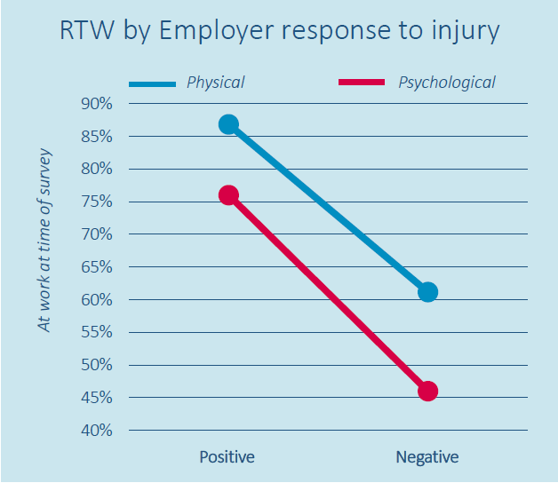
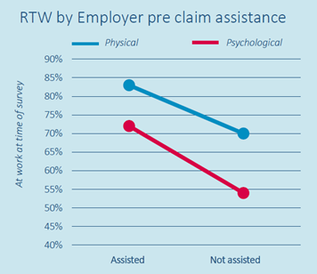
Research – early intervention programs
A study by Wyatt and Iles (2013) reviewed early intervention programs in Victoria. They found that employer support for an injured worker was crucial in predicting a better RTW outcome. In the case of physical injuries, people who feel positively supported by their employer have a 43% higher RTW outcome and workers who receive assistance from the employer before their claim have 19% higher RTW. The benefits are even more marked for psychological injuries.
https://www.racp.edu.au/docs/default-source/default-document-library/what-the-research-is-telling-employers.pdf?sfvrsn=0
Notes:
Untreated mental health conditions are costing Australian employers over $10 billion annually through absenteeism, reduced productivity and workers’ compensation claims, according to 2014 PricewaterhouseCoopers Australia (PwC) research.
Whilst this is a significant cost, Queensland businesses can take heart knowing that investing in mental health action plans can pay dividends. The PwC research Creating a mentally healthy workplace—Return on investment analysis, was conducted for beyondblue and the National Mental Health Commission and suggests businesses can earn a $2.30 return on investment for every dollar they spend on managing mental health.
That’s why managing and preventing mental health problems in the workplace makes sense commercially and benefits worker wellbeing.
WorkCover received over 3,700 mental health claims in 2014-2015 and paid out over $45 million in compensation costs. Workers with mental health claims took on average 91 days off work; over three times longer than any other injury recovery timeframe.

Slide 9
Research – early intervention programs
These programs concentrated on commencing early management within 30 minutes of the event, providing high-level medical care (including referral to a network of preferred providers), minimizing delays through careful case management and intervention at the workplace (developing a positive safety culture in the company).
They found when these steps are followed claims costs were reduced by 34% and the number of days on compensation reduced by 58%.
The positive outcomes may not just be workers’ compensation related but have more broad positive business outcomes through an improved safety culture and a genuine care for workers who are injured at work.
http://www.safeworkaustralia.gov.au/sites/SWA/about/Publications/Documents/853/National-RTWS-role-employer-workplace-2013.pdf
Notes:
Untreated mental health conditions are costing Australian employers over $10 billion annually through absenteeism, reduced productivity and workers’ compensation claims, according to 2014 PricewaterhouseCoopers Australia (PwC) research.
Whilst this is a significant cost, Queensland businesses can take heart knowing that investing in mental health action plans can pay dividends. The PwC research Creating a mentally healthy workplace—Return on investment analysis, was conducted for beyondblue and the National Mental Health Commission and suggests businesses can earn a $2.30 return on investment for every dollar they spend on managing mental health.
That’s why managing and preventing mental health problems in the workplace makes sense commercially and benefits worker wellbeing.
WorkCover received over 3,700 mental health claims in 2014-2015 and paid out over $45 million in compensation costs. Workers with mental health claims took on average 91 days off work; over three times longer than any other injury recovery timeframe.

Slide 10
Research – Barriers to RTW
https://www.comcare.gov.au/__data/assets/pdf_file/0010/158815/04052_CMG_Barriers_to_RTW_v6.pdf
Published Sept 2016 - literature review
The report examines the factors that influence return to work in a workers’ compensation context with a focus on injury characteristics and individual perceptions, and workplace relationships.
Notes:
Untreated mental health conditions are costing Australian employers over $10 billion annually through absenteeism, reduced productivity and workers’ compensation claims, according to 2014 PricewaterhouseCoopers Australia (PwC) research.
Whilst this is a significant cost, Queensland businesses can take heart knowing that investing in mental health action plans can pay dividends. The PwC research Creating a mentally healthy workplace—Return on investment analysis, was conducted for beyondblue and the National Mental Health Commission and suggests businesses can earn a $2.30 return on investment for every dollar they spend on managing mental health.
That’s why managing and preventing mental health problems in the workplace makes sense commercially and benefits worker wellbeing.
WorkCover received over 3,700 mental health claims in 2014-2015 and paid out over $45 million in compensation costs. Workers with mental health claims took on average 91 days off work; over three times longer than any other injury recovery timeframe.

Slide 11
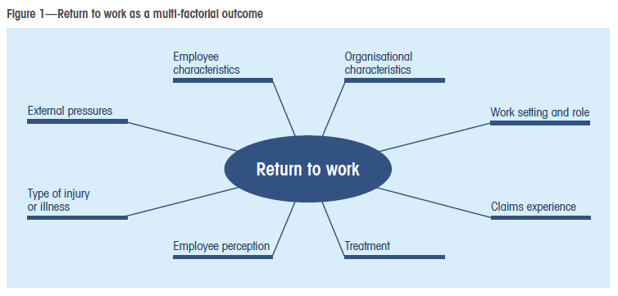
Research – Barriers to RTW
Key findings:
Return to work is a multi-factorial outcome, meaning an injured employee’s experiences and situations are complex and return to work cannot be solely predicted from the physical or medical dimensions of an injury or illness.
Notes:
Untreated mental health conditions are costing Australian employers over $10 billion annually through absenteeism, reduced productivity and workers’ compensation claims, according to 2014 PricewaterhouseCoopers Australia (PwC) research.
Whilst this is a significant cost, Queensland businesses can take heart knowing that investing in mental health action plans can pay dividends. The PwC research Creating a mentally healthy workplace—Return on investment analysis, was conducted for beyondblue and the National Mental Health Commission and suggests businesses can earn a $2.30 return on investment for every dollar they spend on managing mental health.
That’s why managing and preventing mental health problems in the workplace makes sense commercially and benefits worker wellbeing.
WorkCover received over 3,700 mental health claims in 2014-2015 and paid out over $45 million in compensation costs. Workers with mental health claims took on average 91 days off work; over three times longer than any other injury recovery timeframe.

Slide 12
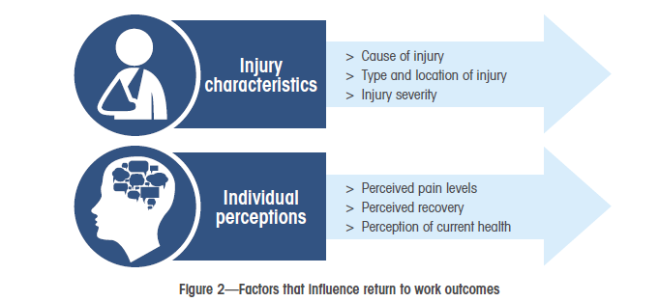
Research – Barriers to RTW
Key findings:
Interventions should consider both the nature of the injury and an individual’s self-assessed health status.
These findings indicate that, in appreciating the multi-factorial nature of return to work, interventions need to be mindful of the factors as they relate to the injury type, severity and location and the perceived pain levels and self-assessed health status. These are important components of the biopsychosocial model, and should not be discounted.
Notes:
Untreated mental health conditions are costing Australian employers over $10 billion annually through absenteeism, reduced productivity and workers’ compensation claims, according to 2014 PricewaterhouseCoopers Australia (PwC) research.
Whilst this is a significant cost, Queensland businesses can take heart knowing that investing in mental health action plans can pay dividends. The PwC research Creating a mentally healthy workplace—Return on investment analysis, was conducted for beyondblue and the National Mental Health Commission and suggests businesses can earn a $2.30 return on investment for every dollar they spend on managing mental health.
That’s why managing and preventing mental health problems in the workplace makes sense commercially and benefits worker wellbeing.
WorkCover received over 3,700 mental health claims in 2014-2015 and paid out over $45 million in compensation costs. Workers with mental health claims took on average 91 days off work; over three times longer than any other injury recovery timeframe.

Slide 13
Research – Barriers to RTW
Key findings:
Workplace relationship factors can positively influence return to work
Notes:
Untreated mental health conditions are costing Australian employers over $10 billion annually through absenteeism, reduced productivity and workers’ compensation claims, according to 2014 PricewaterhouseCoopers Australia (PwC) research.
Whilst this is a significant cost, Queensland businesses can take heart knowing that investing in mental health action plans can pay dividends. The PwC research Creating a mentally healthy workplace—Return on investment analysis, was conducted for beyondblue and the National Mental Health Commission and suggests businesses can earn a $2.30 return on investment for every dollar they spend on managing mental health.
That’s why managing and preventing mental health problems in the workplace makes sense commercially and benefits worker wellbeing.
WorkCover received over 3,700 mental health claims in 2014-2015 and paid out over $45 million in compensation costs. Workers with mental health claims took on average 91 days off work; over three times longer than any other injury recovery timeframe.

Slide 14
worksafe.qld.gov.au
1300 362 128
Notes:
Questions?

