Slide 1
WorkCover Update
Barbara Martin
Regional Manager
13 February 2013

Slide 2
Agenda
Common law
Statutory claims (firer fighter claims)
Value add services for our customers
Notes:
Text

Slide 3
Common law claims trends
Registration stable- 3860
Average claims cost still decreasing
Trial outcomes 78% win (up from 54%)
Success with best offer policy
Way of Working- Panel and In-house
Notes:
Text

Slide 4
Common law claims trends
Common law Judgements
Wilmink v Clifton Park Turf Supplies Pty Ltd [2012] DCB Reid J 21 December 2012
Worker agricultural/horticultural farmer sustained a compound fracture to his left lower leg when he was pinned between bucket and loader of tree. Quantum only trial. Returned worker to workplace and subsequently he obtained a new job as a horticultural farmhand.
Worker presented as creditable witness and Judge Reid made a favourable future economic loss finding. Although he has overcome much of the loss of earnings his disability does mean that he is likely to suffer some loss by way of reduced profits in the future.

Slide 5
Latent onset - Update Fire Fighter claims
7 claims; 4 have been decided
Injury type: cancers- kidney, testicular, bowel
Injury exposure - range from 10 to 40 years, vary from specific chemical fires to general smoke fires
Investigations included:
Factual
Treating specialist- Oncologists, Urologists
Independent review- Occupational Physician
Notes:
Text

Slide 6
Working with Workplace Health and Safety
Injury Prevention and Management Program (IPAM)
Grow Safe Business
Training for our people
Notes:
Text

Slide 7
Industry microsites now available for Retail & Wholesale
Notes:
Text

Slide 8
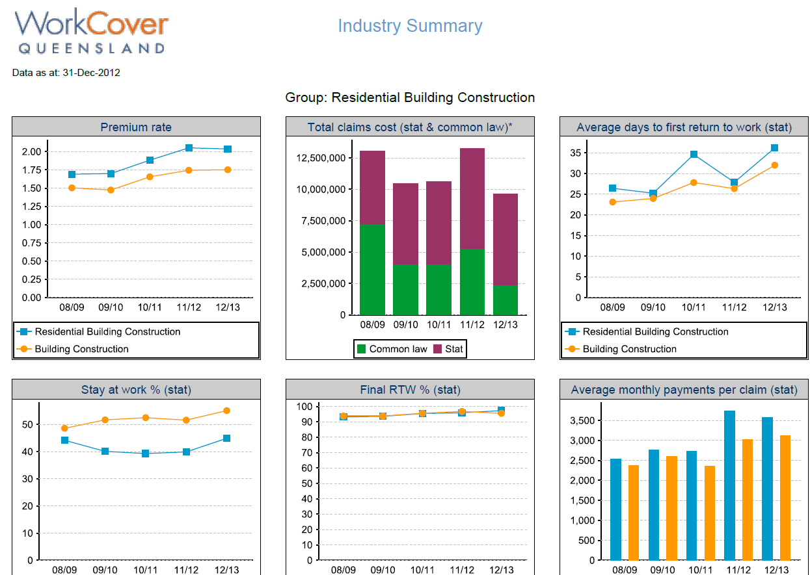
1st rtw and stay at work for Industry
Notes:
Coming in March

Slide 9
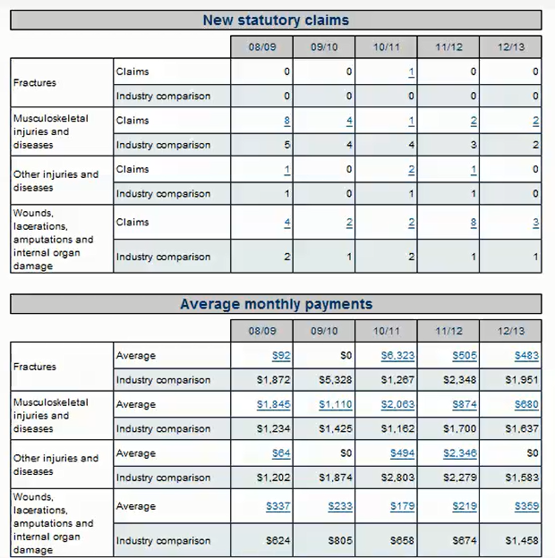
Injury nature and injury location for employers
Notes:
Coming soon and also looking at industry presentations, when we have that info can share

Slide 10
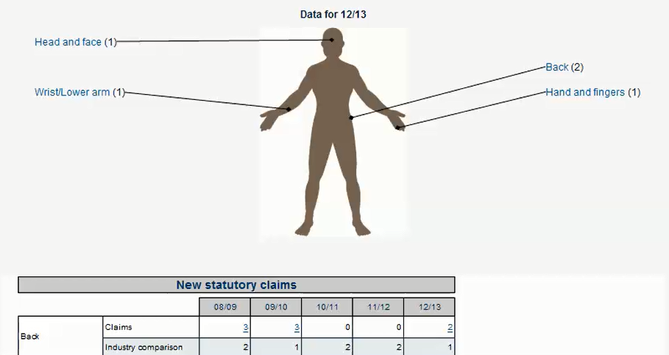
Injury nature and injury location for employers
Notes:
Coming soon

Slide 11
GP and Allied Health information
Assist with cost, return to work and stay at work.
Developing information for discussion
Number of consultations
Days between consultations
Days to finalisation (paid days)
Days to first return to work
Final return to work outcome %
Number of 1st medical certificates given for time lost, suitable duties, and medical expenses only
Notes:
Text

