Slide 1
Australian Health Benefits of Good Work Signatory Steering Group
Realising the Health Benefits of Good Work
Sue Richardson
Notes:
Thank you for the opportunity to present to you today on the HBGW Agenda.
Over the last couple of forums I have provided you with an update on our participation as a member of the Signatory Steering Group.
Today’s presentation is in part is providing an update on what is new in this area;
however the purpose of today session is also enable you to consider what does the HBGW mean to your business and how your business may wish to consider further participation to drive both employee and business outcomes.
The Health Benefits of Good Work (HBGW) is an initiative from the Australasian Faculty of Occupational and Environmental Medicine (AFOEM) of The Royal Australasian College of Physicians (RACP).
This initiative is based on compelling Australasian and international evidence that good work is beneficial to people’s health and wellbeing and that long term work absence, work disability and unemployment generally have a negative impact on health and wellbeing.

Slide 2
Australian HBGW Signatory Steering Group
The Australian Faculty of Occupational & Environmental Medicine (AFOEM) established the Health Benefits of Good Work (HBGW) Stakeholder Executive Group in September 2014 to determine the strategic direction for the implementation of health benefits of work into the industry and health sectors to advance the Royal Australasian College of Physicians (RACP) policy.
The Stakeholder Executive Group recommended the formation of two steering groups to develop and implement coordinated initiatives into both industry and health sectors.
The Australian Health Benefits of Good Work (HBGW) Signatory Steering Group (SSG) is the industry steering group, comprising a range of stakeholders including statutory authorities, healthcare organisations, insurers and national employers.
Notes:
By way of background if anyone is aware
In September 2014 saw the Australian Faculty of Occupational & Environmental Medicine establish the HBGW Stakeholder Executive Group to determine the strategic direction for the implementation of the HBGW into both industry and health sectors.
This results in the recommendation of two Steering Groups (Industry and health).
The SSG is the industry group and ASIEQ is a stakeholder on this group, myself being your representative.
The Health industry group has just in formation.
Also now NZ has also an established SSG.
Our deliverables are governed by the Royal Australasian College of Physicians, given it is there policy which is being implemented.

Slide 3
Australian HBGW Signatory Steering Group Membership
Suzanne Jones (Chair) Xchanging
Morag Fitzsimons (Deputy Chair) WCD
Sue Richardson, Association of Self-Insured Employers Queensland (ASIEQ)
Annette Williams, Australian Rehabilitation Providers Association
Rebecca Parton, Comcare
Kathryn Hogg, Employers Mutual
Mary Maini, Financial Services Council (rotating position)
Ray Collins, Police Association of New South Wales
Amy Ho, Royal Australian College of General Practitioners
Carly Van Den Akker , Swiss Re
Nikki Brouwers, The Interact Group
Warren Harrex, Royal Australasian College of Physicians
Megan Buick, TAC and Victorian WorkCover Authority
Notes:
Members of the SSG comprise of
Statutory authorities
Insurers
Health care organisations
National Employers

Slide 4
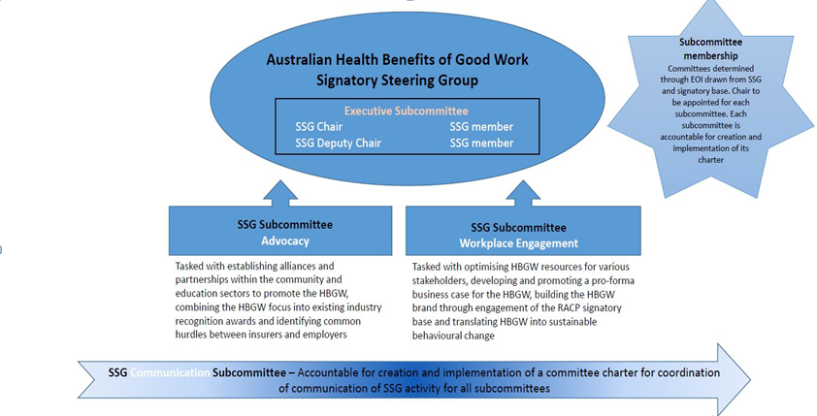
Notes:
ASEIQ’s role presently is in the Workplace Engagement Subcommittee

Slide 5
The Workplace Engagement Subcommittee’s focus is to enhance engagement with workplaces across Australia to champion the integration of the HBGW policy agenda.
Key objectives of the Workplace Engagement Subcommittee are to:
Engage with workplaces to implement good practice and maximise people’s access to the HBGW
Support workplaces to reframe and refresh activities to increase awareness of, promote and deliver HBGW
Establish networks to broaden the awareness that HBGW increases the health and wellbeing of employees
Notes:
The focus of the Workplace Engagement Subcommittee is to enhance engagement with workplaces across Australia to champion the integration of HBGW policy agenda.
Understandably we have valuable connections in this area; and it is on this basis that I believed timely to position to you opportunities that may be available to your individual businesses.

Slide 6
Shared Agenda
At the heart of the Australian Consensus Statement on the Health Benefits of Work is a shared desire to improve the welfare of individuals, families and communities.
Employers are a central stakeholder in the shared agenda to positively influence and drive outcomes in the promotion and awareness of the health benefits of good work.
Notes:
At the heart of the Australian Consensus Statement on the HBGW is a shared desire to improve the welfare of individuals, families and communities.
Given the industry we have all chosen to work in, generally this is close to our heart – all we all have a passion (either through care or risk mitigation) to achieve this.
Employers are a central stakeholder;
and
through what your company is already delivering; we are influencing and driving outcomes with respect to the benefits of returning to work.
It makes good business sense for us and it supports our employees.

Slide 7
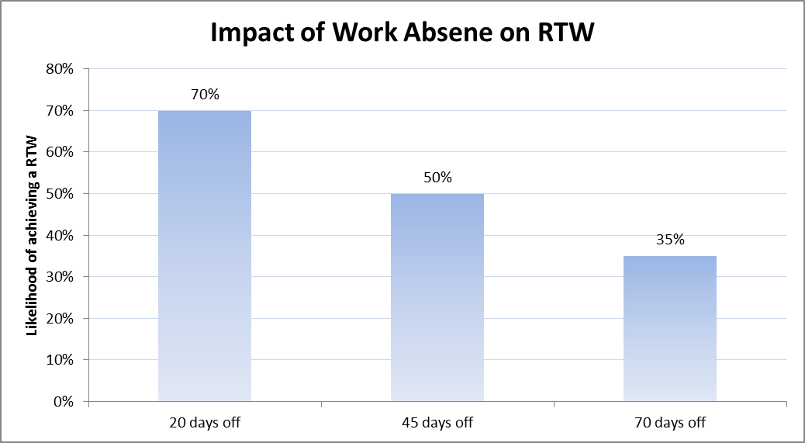
Sustainable Behavioural Change Imperative
There is movement in the industry; an opportunity for us as employers to join and contribute
Workers’ Compensation Regulator driving change with the introduction of the New Medical Certificate
Rehabilitation for non-work related injuries
Life Insurance integrating HBGW and working collaboratively with other insurers
Notes:
The opportunity for us now is to support sustainable behavioural change.
We know it and the evidence supports it;
the longer you are off work the reduced likelihood of return to sustainable employment.
20 days 70% return; down to 70 days 35% of ever returning.
There is movement in the industry; there is a need for a paradigm shift across all stakeholders including; government; employers, unions; legal practitioners; health professionals…
We are seeing different and varied - initiatives; - expectations and - change as different stakeholders start to drive the agenda.
For example; the OIR is driving change with the introduction of the new medical certificate .
Many organisations are extending their rehabilitation to manage non-work related
Life Insurance are working collaboratively with other insurers on a shared outcomes;
And I’m confident there are many other initiatives that are driving sustainable change, either locally within your team; your organisation or more globally.
The opportunity is to share these learnings….

Slide 8
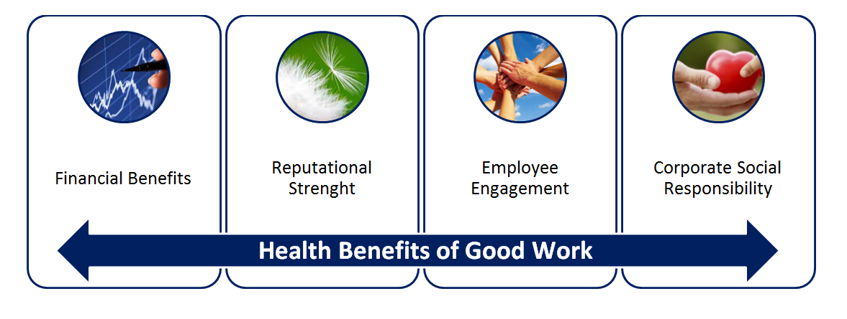
Delivering Outcomes for Business through HBGW initiatives
Notes:
Maximising an employees’ access to the health benefits of good work has far reaching benefits to employers beyond limiting worker’s compensation and absenteeism costs.
It leads companies towards achievement
of their corporate social responsibility,
produces increased productivity,
enhances employee engagement and
strengthens their brand in the competitive market.
The single biggest investment an employer will make is in their human resource capital, their ‘people’.
The investment in people, through recruitment and training, needs to demonstrate a return in productivity and financials for the company.
If employees are not present at work, either physically or engaged, then achievement is not attainable.

Slide 9
How do we translate HBGW into Sustainable Behavioural Change?
Notes:
So what are some options / resources available to businesses….

Slide 10
Become a HBGW Signatory Organisation
HBGW Consensus Statements
Purpose is to bring together a wide range of stakeholder signatories, who each affirm the importance of work as a determinant of health and commit to:
promoting awareness of the health benefits of good work
offering support and encouragement to those attempting to access the health benefits of good work
encouraging employers' continuing support of workers' occupational health
advocating for continuous improvement in public policy around work and health
Charter of HBGW Principles
Draws out the key principles from the HBGW philosophy.
This Charter is intended for all Signatories to display in their own facilities to reaffirm their commitment to the principles outlined in the Consensus Statement and companion position statements and the importance good work can play in contributing to people’s health and wellbeing.
How? – access information and registration at racp.edu.au
Notes:
Consider your organisation becoming a signatory.
Becoming a signatory means you’re supporting the HBGW Consensus Statement
HBGW Consensus Statements
Purpose is to bring together a wide range of stakeholder signatories, who each affirm the importance of work as a determinant of health and commit to:
promoting awareness of the health benefits of good work
encouraging employers' continuing support of workers' occupational health
advocating for continuous improvement in public policy around work and health
In a lot of instances your organisation is already supporting HBGW through your vision; policy and procedures. Becoming a signatory is re-inforce this commitment.
The process is as easy as 1,2, 3
Log online at the racp.com.au website.
Provide information regarding;
“How does the Health Benefits of Work align to your organisation?
If your organisation is approved as a signatory, how would you propose to promote the Health Benefits of Work?
The charter then provides scope for you to promote your commitment.

Slide 11
Resources Available
RACP Health Benefits of Good Work web page
Dedicated resource section www.racp.edu.au
https://www.racp.edu.au/advocacy/division-faculty-and-chapter-priorities/faculty-of-occupational-environmental-medicine/health-benefits-of-good-work
Industry forum reference material
Bi-annual Newsletter
HBGW Forums
Access to Signatory’s to share learnings through case studies
Business Case
Notes:
Website
Dedicated page continuing to evolve as more resources are created and case studies developed.
Includes presentations from May forum including an interesting presentation by Mary Wyatt relating to “What research is telling us around benefit of early contact and increases in RTW”.
Newsletter issued by the college
HGBW Forums – twice yearly
Access to signatories
And the development of a pro-forma business case…..

Slide 12
Realising the HBGW Business Case
This business case is an initiative of the SSG
The template has been created to assist in the operationalization of HBGW in your organisation.
Intention is to provide you with easy access to information which supports implementation and evaluation of an evidence based Health Benefits of Good Work Program.
It is a guide that allows you to plan for and track key initiatives to determine the cost-effectiveness of your investment.
Notes:
The proforma business case.
This business case is an initiative of the SSG; of which we have been a integral part of the development.
The template has been created to assist in the operationalization of HBGW in your organisation.
Intention is to provide you with easy access to information which supports implementation and evaluation of an evidence based Health Benefits of Good Work Program.
It is a guide that allows you to plan for and track key initiatives to determine the cost-effectiveness of your investment.
It steps through ….

Slide 13
Scope of the Business Plan
Framing the tangible business benefits
Framing the intangible business benefits
Measuring success
Pulling your business case together
1
2
3
4
Interested in applying the business case in your organisation; speak with members of the SSG Workforce engagement Sub-Committee; contact details at the end of presentation.
Notes:
Framing the tangible business benefits
The rationale for the health benefits of good work;
Identifying key stakeholders across your business;
Data and analysis;
Internal business initiatives;
Presenting the cost benefit analysis.
Framing the intangible business benefits
Educating the workforce;
Educating the management team;
Considering other intangible benefits;
Growth; Customer service experience; Staff engagement; turnover;
Measuring Success
Initiatives and measurements of success; suggested objectives and measurements;
Examples of companies achieving success through case studies;
Pulling your business case together
The initiative of the Workplace Engagement Sub-Committee is to work with an organisation in implementing the business case and sharing the learnings through that process; therefore if any organisation is interested, I would be happy for them to contact myself directly to explore this further.

Slide 14
Other Initiatives…
Developing HBGW resources for stakeholders
Establish alliances and partnerships within the community and educations sectors
Combine the HBGW focus into existing industry recognition and awards programmes
Implementation and shared learnings from application of the business case
Build profile through engagement with signatory base
Identify common hurdles between employers & Insurers
Translating HBGW into behavioural change
Notes:
Other Initiatives that are being driven across the SSG include;
Developing resources available to all stakeholders regarding messaging of HBGW
Expanding partnerships/alliances within the community and education sections; including unions.
Combining the HBGW focus into existing industry recognition programs
Implementing and shared learnings from application of the business case.
With the goal of translating HBGW into behavioural change.
Regularly reviewing based on industry needs and position.

Slide 15
Working together…
The SSG is keen to partner with other parties to progress the initiatives of work of the group. You do not have to be an existing signatory to participate. This can be done by
Invitation to join a working party;
Nominating or expressing interest in work with the SSG members on a particular initiative;
Participation may be for a defined period or the entire duration of a project or initiative.
A primary goal of the SSG is to share information, particularly the success stories associated with the implementation of the Health Benefits of Good Work.
If you would like to participate; support the SSG or obtain more information please connect with members of the SSG.
Notes:
The primary goal of the SSG is to share information and working together is a way forward.
As discussed there are opportunities for those organization interested to become a signatory;
Opportunity to apply the business case in your organization, and be supported and share the learnings with the SSG
However there are other opportunities for partnership through invitations to work on specific initiatives and or join working parties.
There are clear opportunities through our association to enhance and extend the engagement through our company’s…
If you’re interested in any further information or these opportunities; if you can please connect with myself and I’m happy to discuss with you or escalate to the appropriate member on the Steering group.
Contact points include…..

Slide 16
Contact Points
RACP Website
Executive
Suzanne Jones, Xchanging
Morag Fitzsimons, WCD
Annette Williams, ARPA
Workplace Engagement Sub-Committee
Nikki Brouwers, The Interact Group
Rebecca Parton, ComCare
Mary Maini, Financial Services Council
Sue Richardson, ASIEQ via
asieq@asieq.com.au
Notes:
Website; and members of the SSG

Slide 17
Realising the Health Benefits of Good Work
Office of Industrial Relations, Qld
Video link - WorkSafe
Video link – You Tube
Notes:
Thought it would be great to end with sharing a recent film pulled together by the OIR which summaries the Health Benefits of good work at the core.
Voice over is by Rachel

Slide 18
Australian Health Benefits of Good Work Signatory Steering Group
Realising the Health Benefits of Good Work
Sue Richardson
Notes:
Any questions or happy for you to email me directly.
Thank you for your time and I look forward to continuing to represent you in our commitment to the HBGW.

